Slide 1
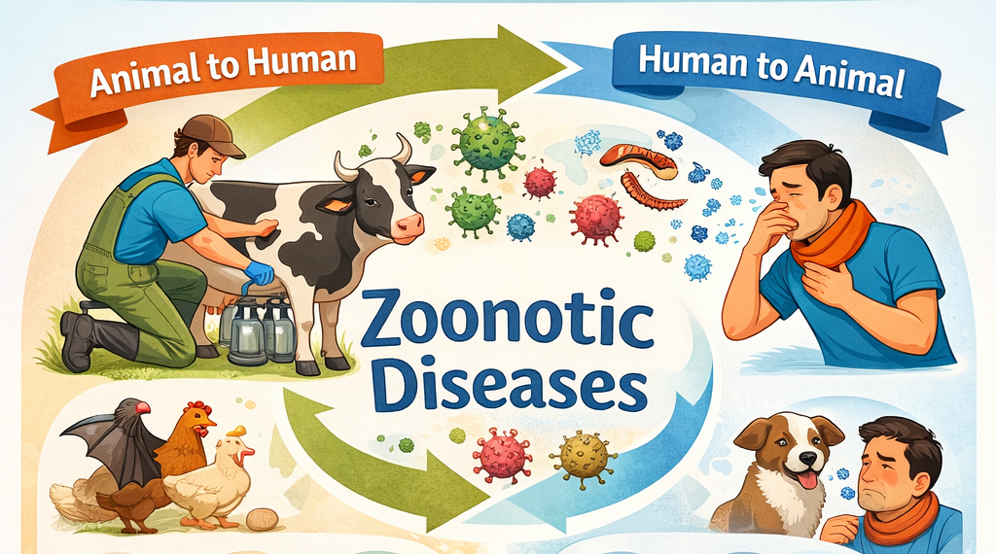
Zoonotic Diseases
Zoonotic diseases (zoonoses) are diseases that can be transmitted between animals and people.
There are over 200 zoonotic diseases worldwide.
60% of known infectious diseases of people are zoonotic.
Zoonotic diseases are an important health risk and concern for people and animals.
Most zoonotic diseases can be avoided with proper prevention measures.
Source: CFSPH – Zoonotic Diseases
Notes:
Last time we talked about types of diseases that can be found on a dairy farm, today we’ll talk about how diseases are transmitted.

Slide 2
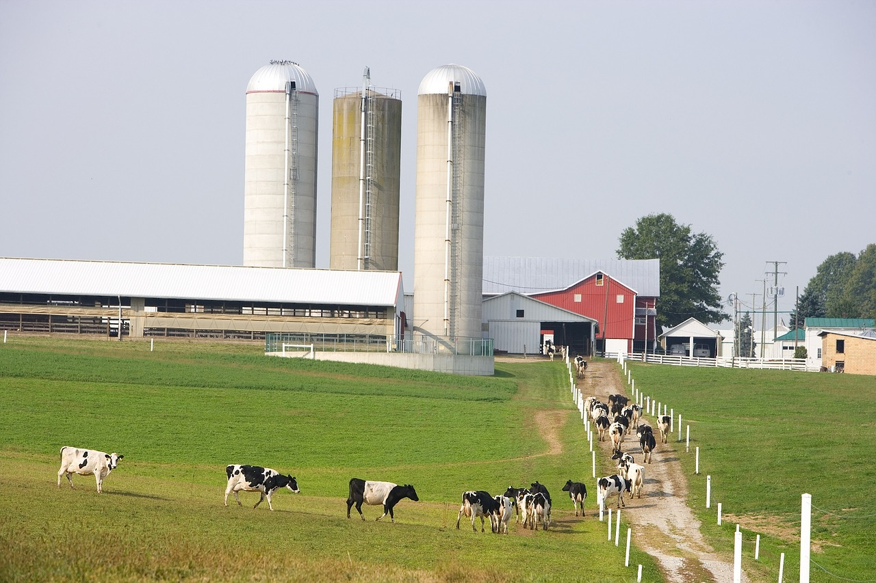
Transmission Routes for Diseases on Dairy Farms
There are five common routes of transmission:
1. Direct contact
2. Indirect contact (fomites)
3. Airborne
4. Ingestion
5. Sharps
Notes:
There are five common routes of disease transmission. Some pathogens are passed through multiple routes at once.

Slide 3
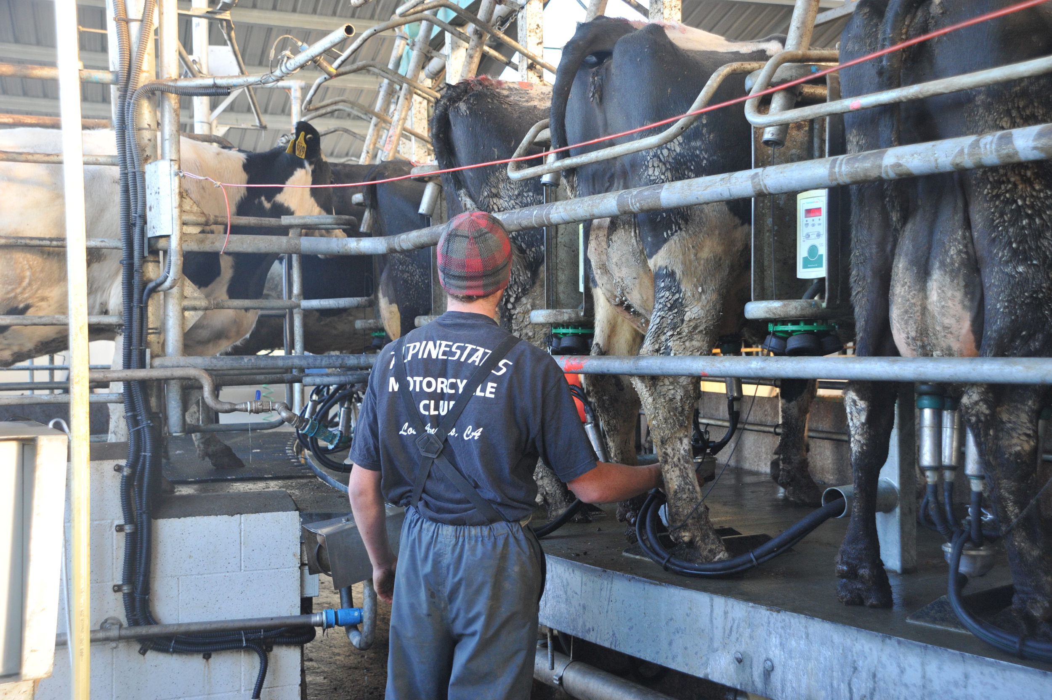
Transmission Routes : Direct Contact
Touching infected animals, their waste or bodily fluids.
Notes:
Direct contact includes touching infected animals, their waste, or bodily fluids
Examples: A worker assists with calving and gets amniotic fluid in an open cut.
Ask the audience for other examples.

Slide 4
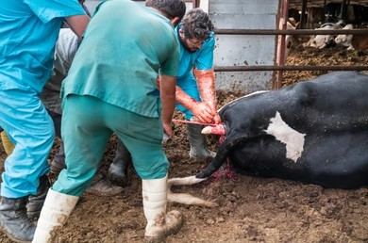
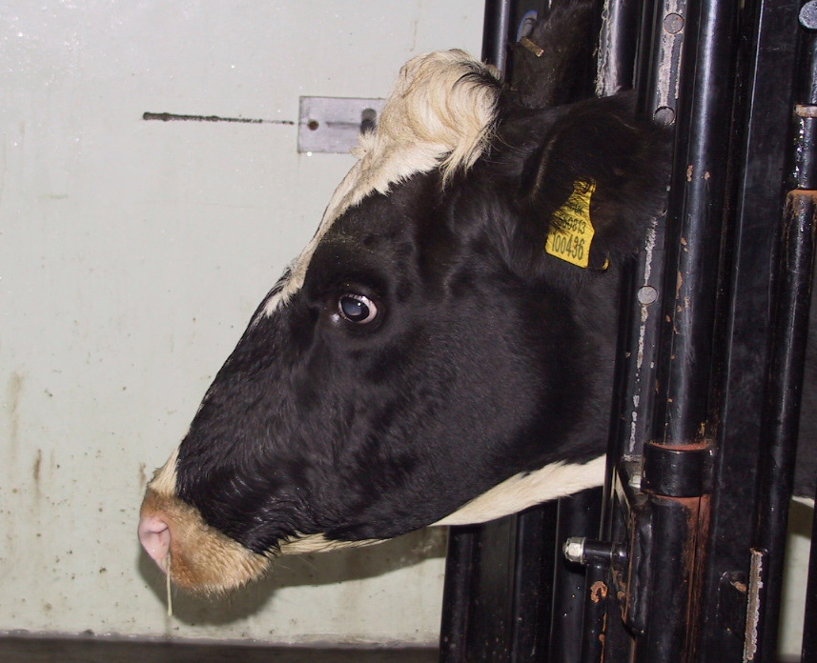
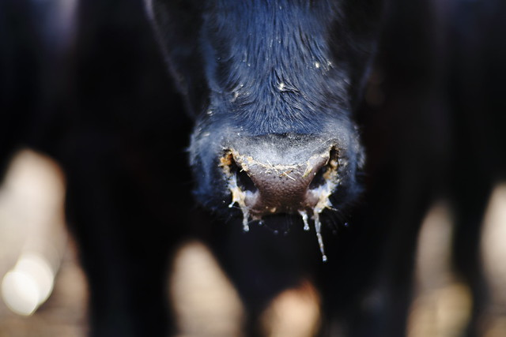
Transmission Routes : Direct Contact
Reference: TTT Self-Guide Manual (Page 12-13)
Notes:
Direct contact includes touching infected animals, their waste, or bodily fluids
Example: A worker assists with calving and gets amniotic fluid in an open cut
Ask for other examples

Slide 5
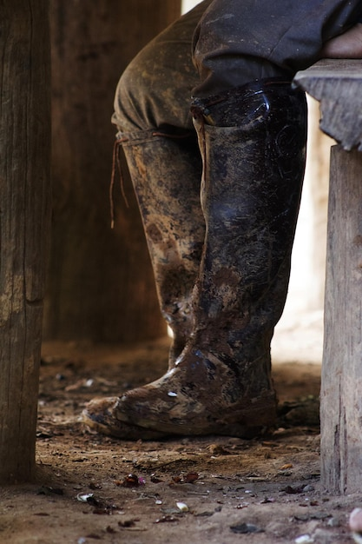
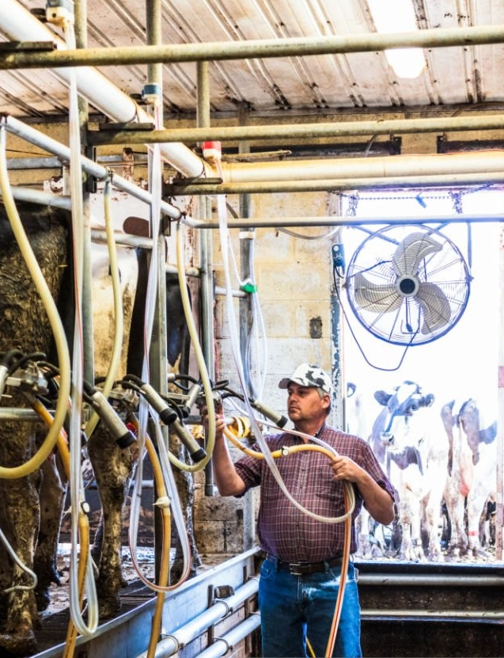
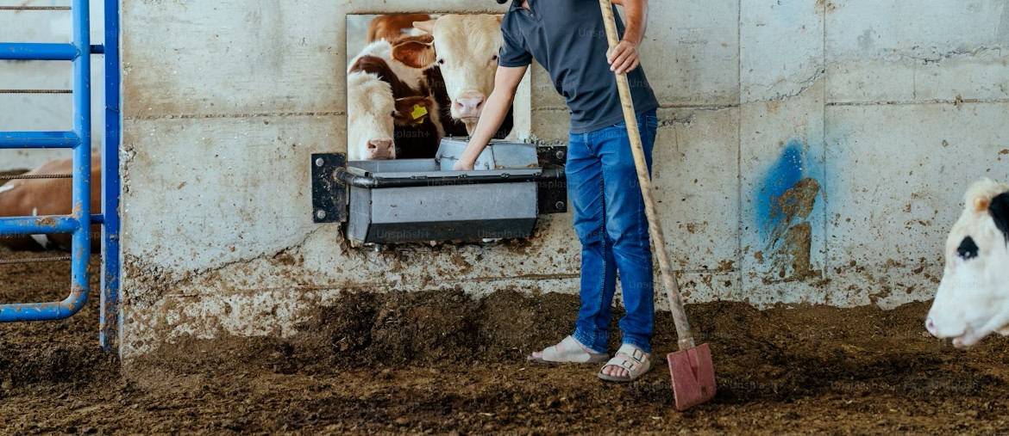
Transmission Routes : Indirect Contact
Touching contaminated objects or surfaces.
Notes:
Indirect contact includes touching contaminated objects or surfaces. These areas are called “fomites”
Example: Milking equipment contaminated with manure is touched and then the worker rubs their eye
Images of door knobs, milking equipment, microwaves, faucets

Slide 6





Other fomites include…
Breakroom Microwaves
Cell Phones
Doors (with handles, knobs or push)
Breakroom faucet handles
Notes:
Fomites can also be things that people touch throughout the day. And if hands aren’t clean when they are touched, they can be places where pathogens are transmitted.

Slide 7
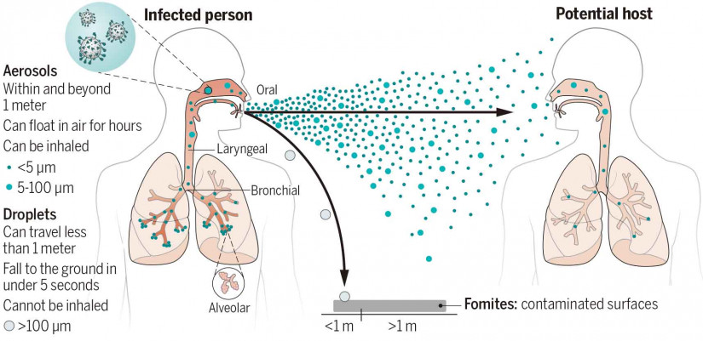
Transmission Routes : Airborne
Reference: TTT Self-Guide Manual (Page 12-13)
Notes:
Airborne transmission, the inhalation of Aerosols or Dust, includes breathing infectious particles suspended in air.
Example: Inhaling dust in a barn with Q fever

Slide 8
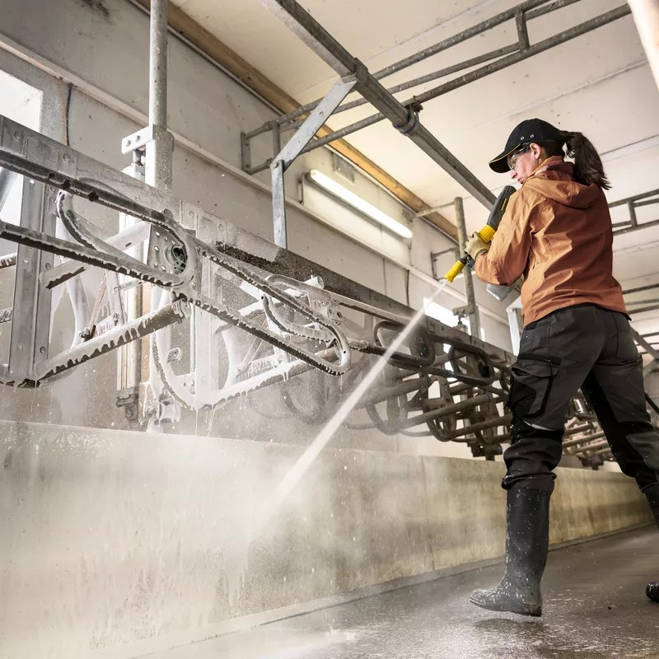
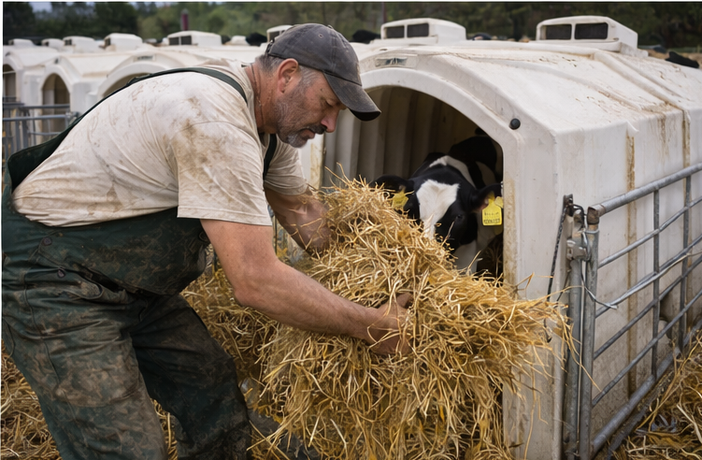
Transmission Routes : Airborne
Notes:
Particles can be accelerated through the air by spray or fans in the environment, or through moving dusty items.

Slide 9
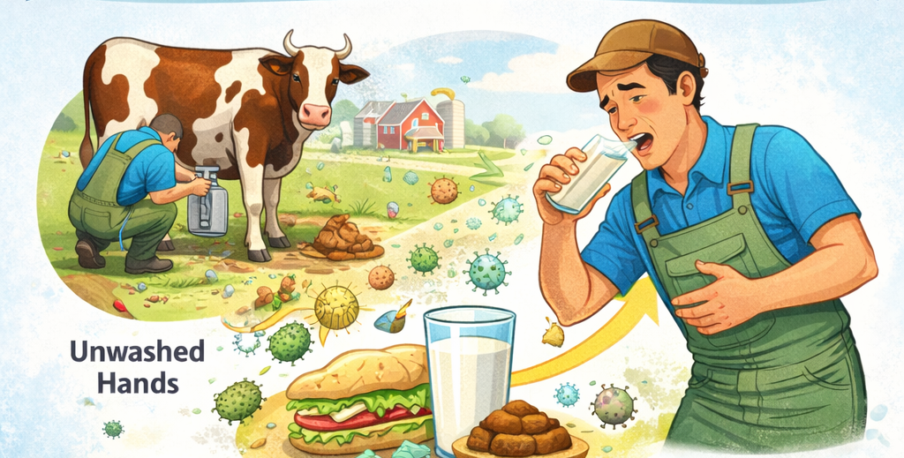
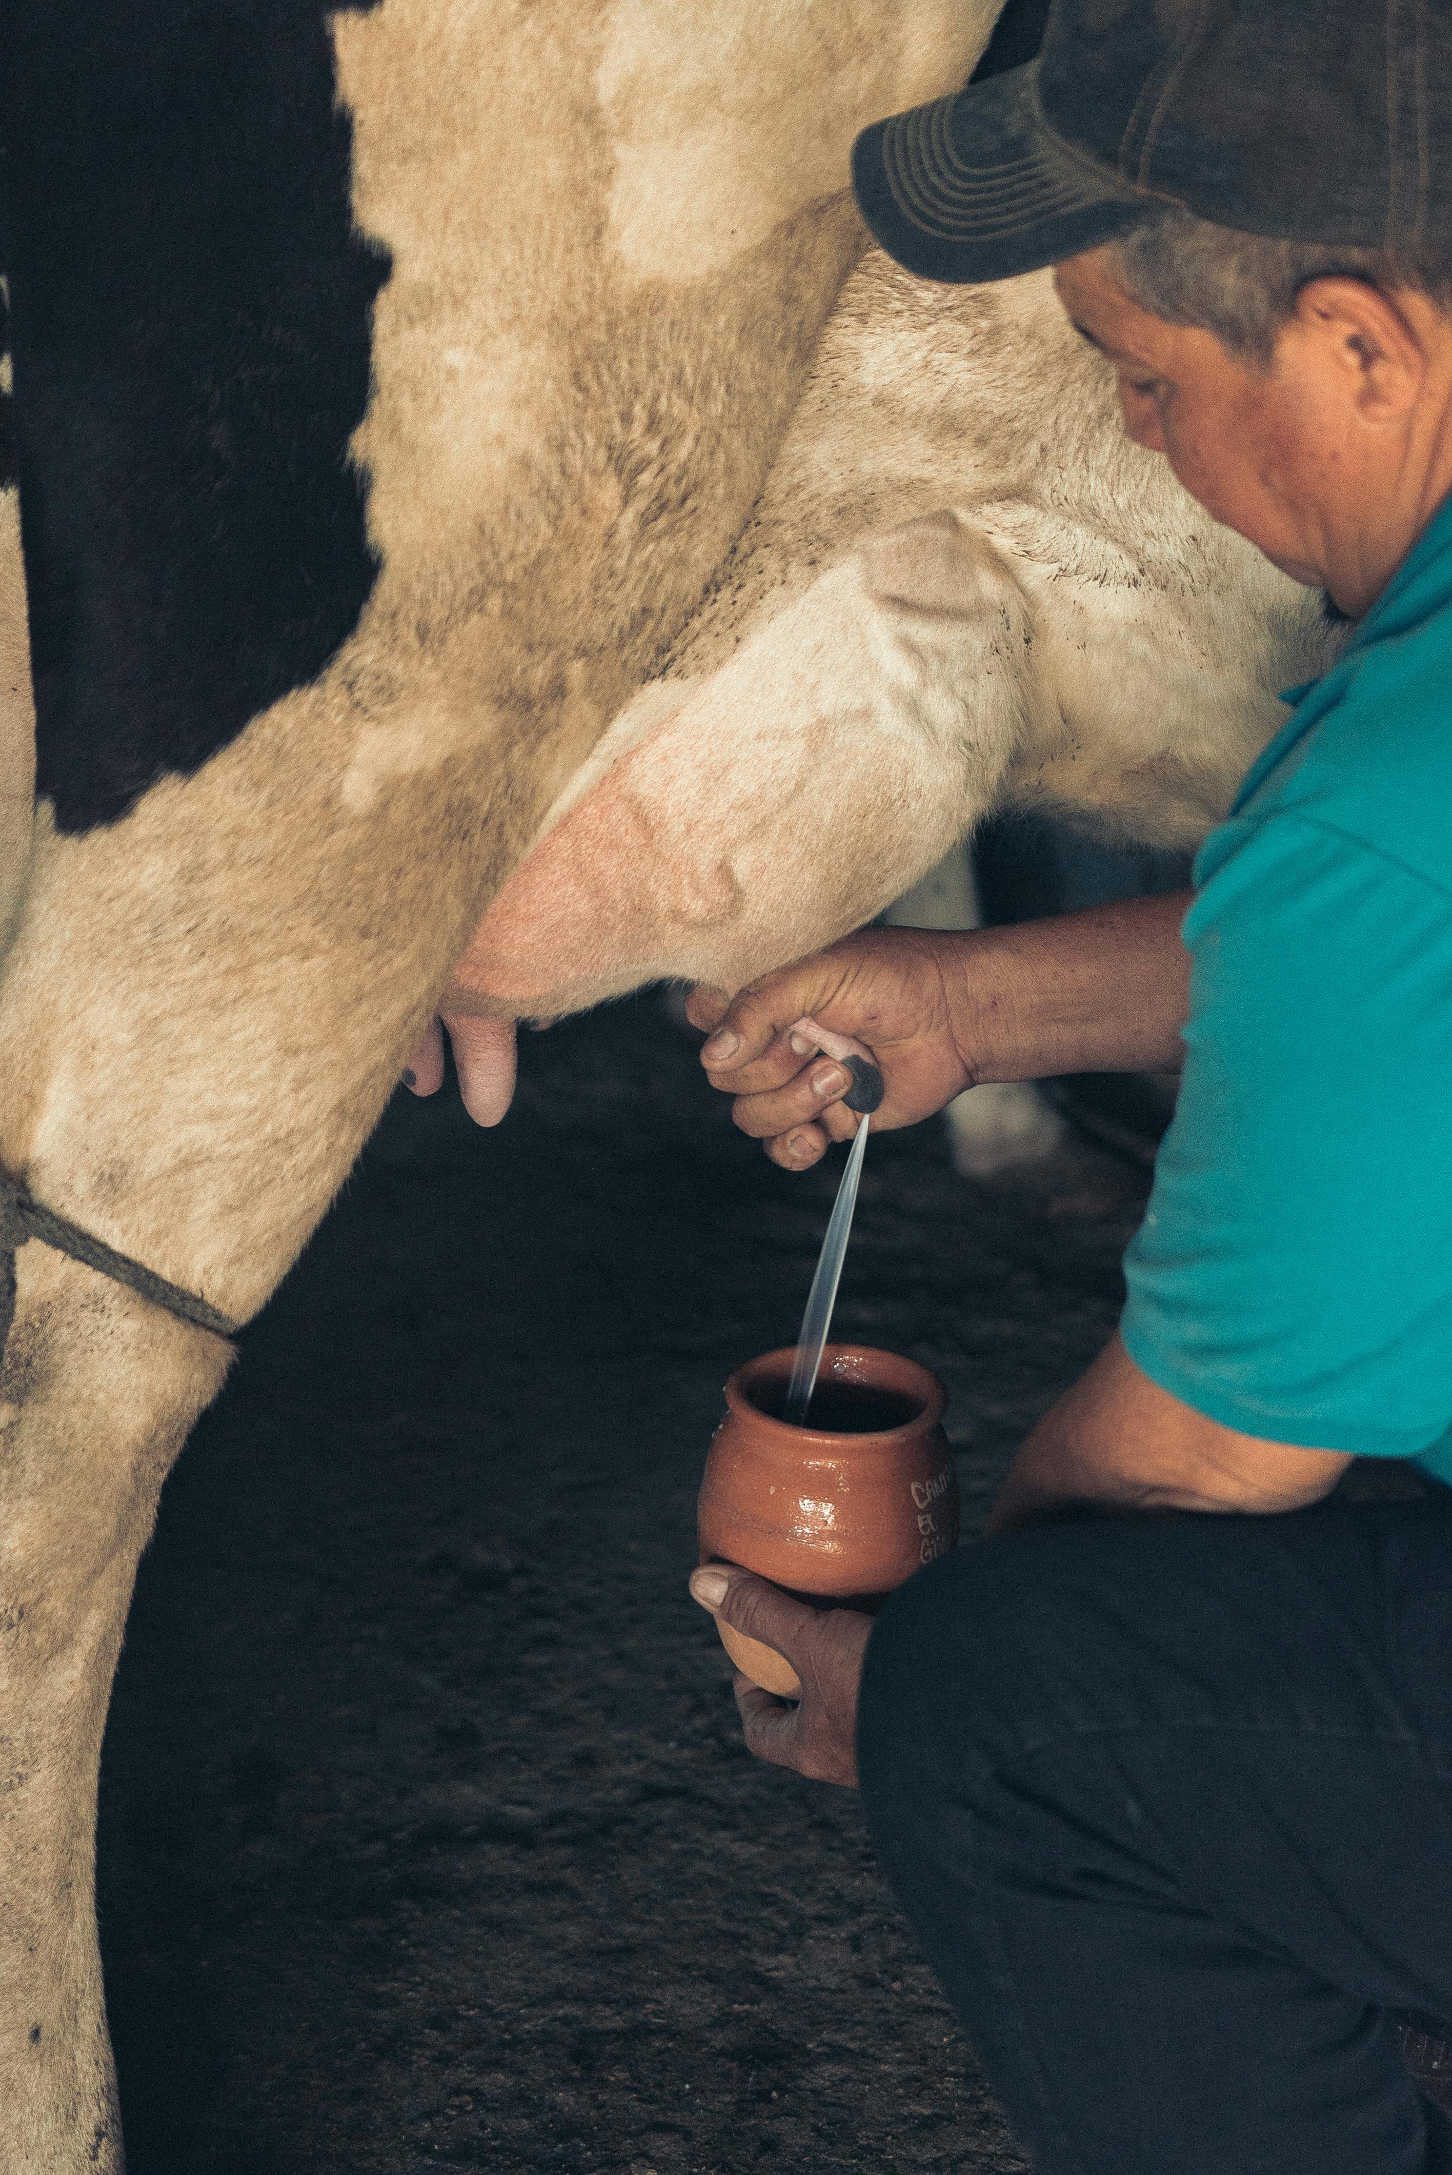
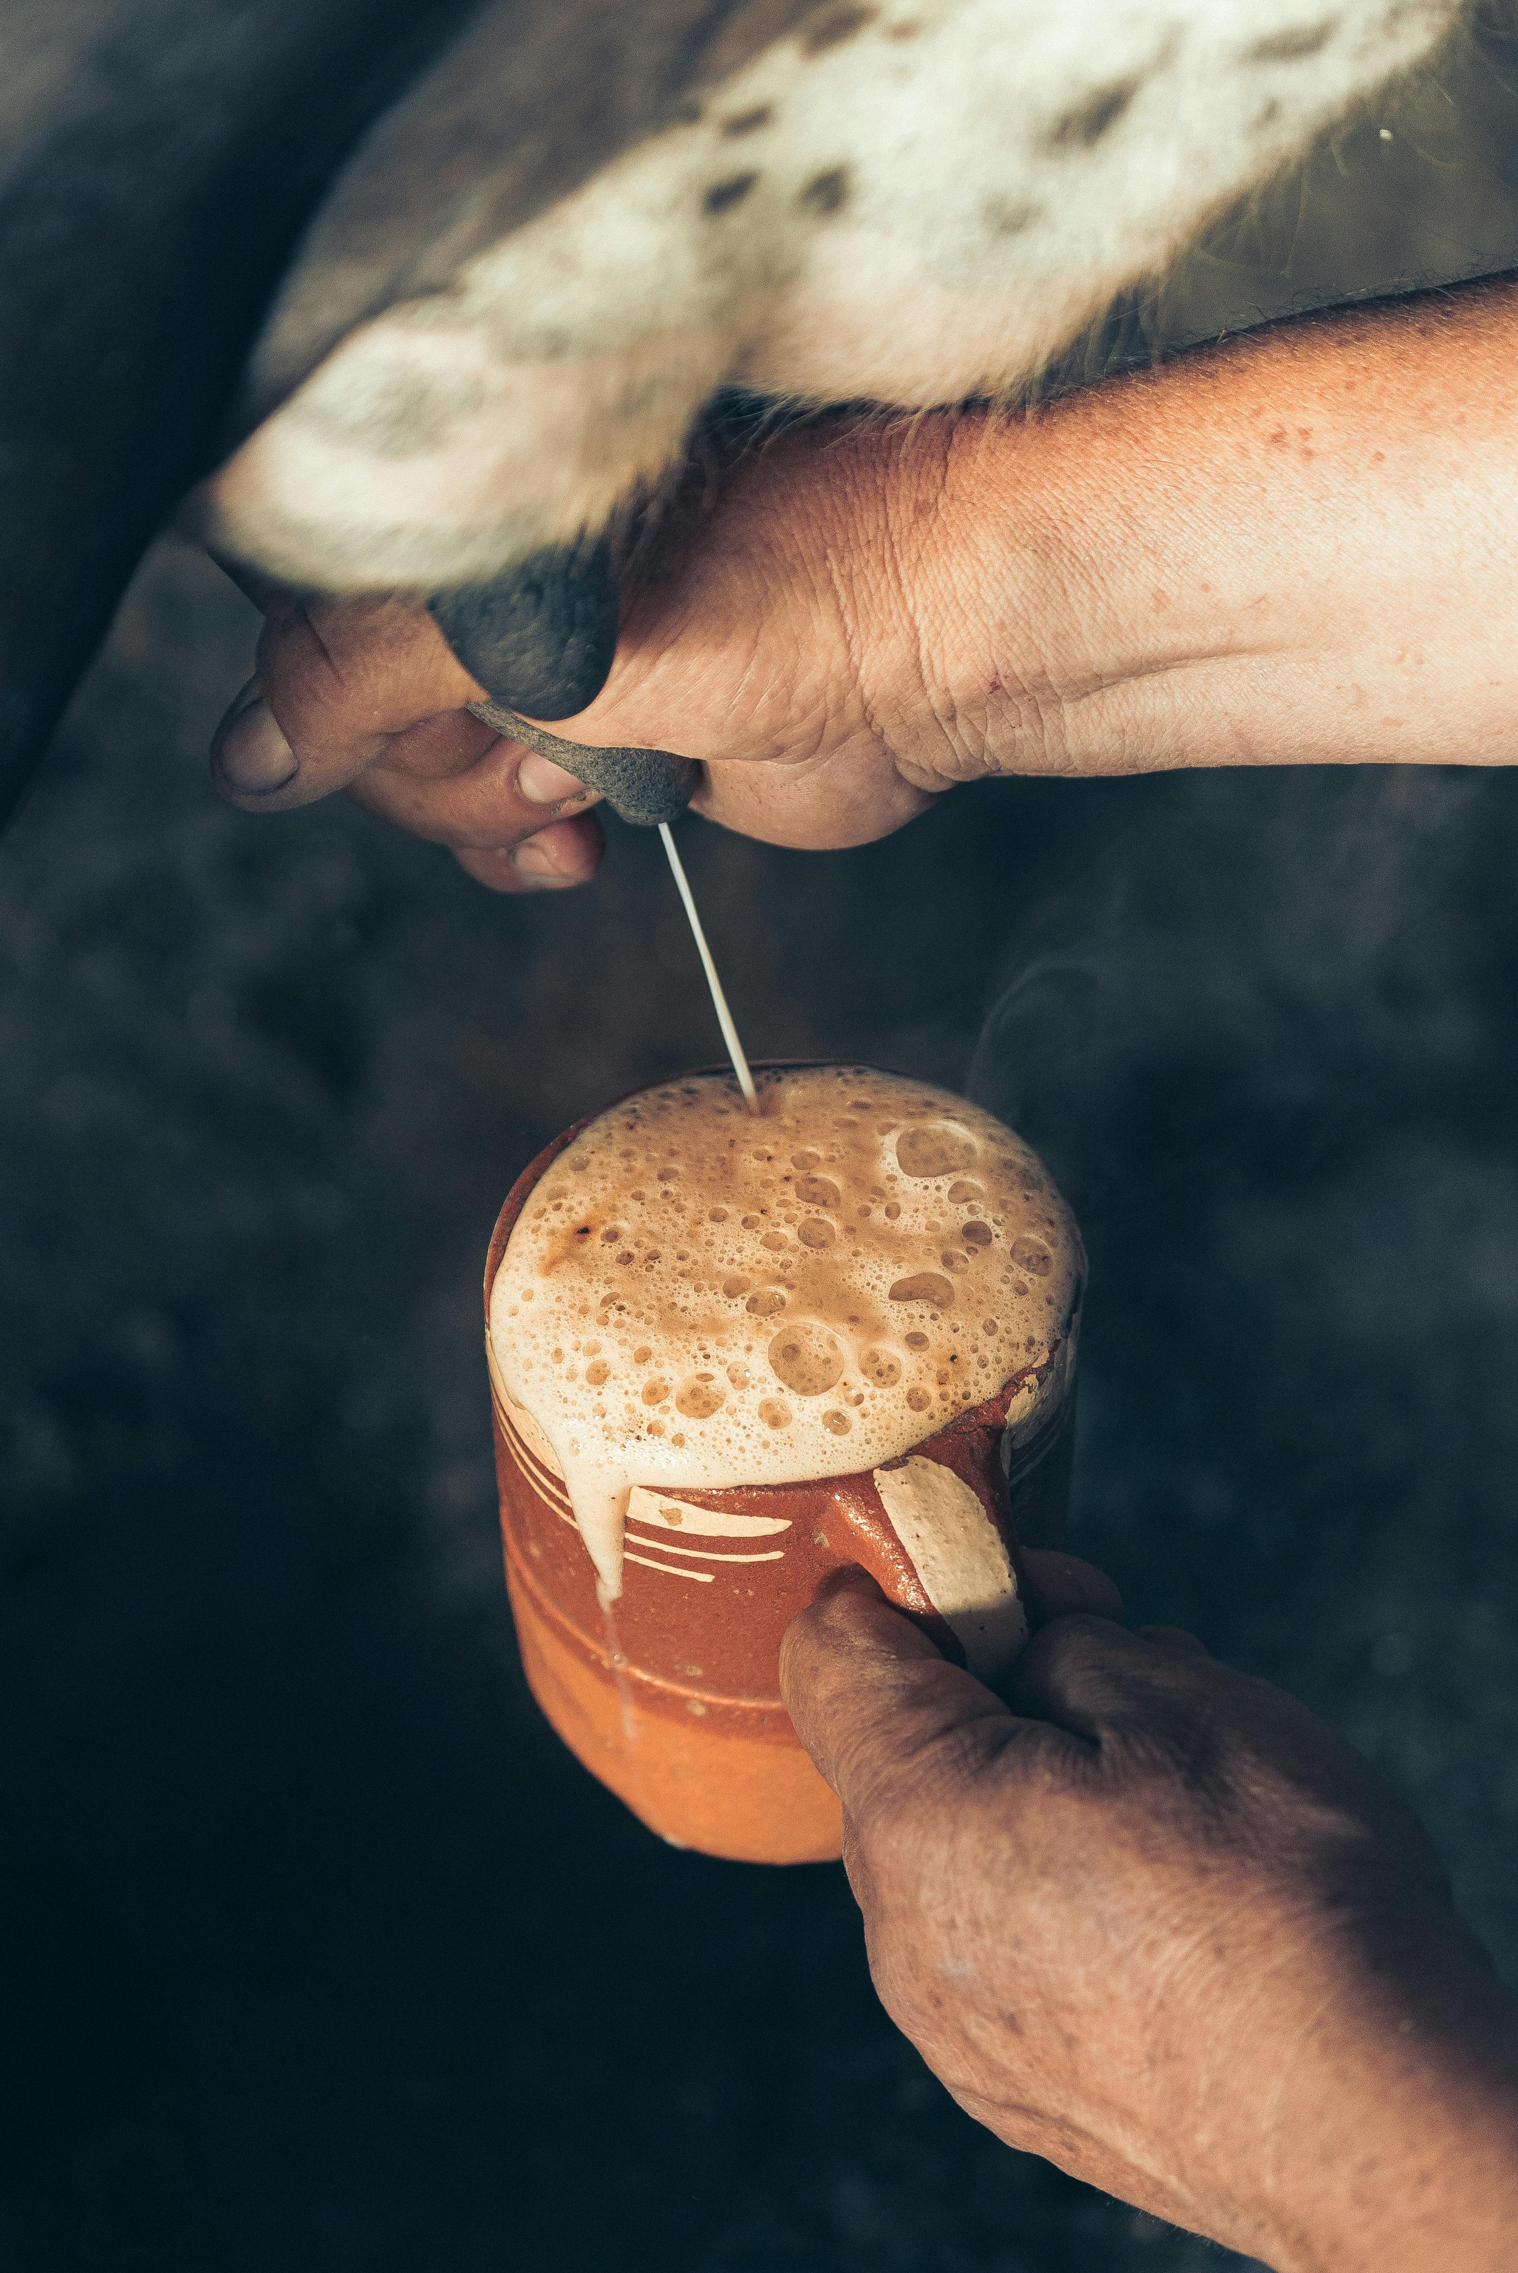
Transmission Routes : Ingestion
Ingesting contaminated food, water or transmitted by unclean hands
Notes:
Ingestion includes swallowing contaminated food or water or transmitted by unclean hands to the mouth.
Example: A worker eats lunch without washing hands after handling calves with diarrhea.

Slide 10
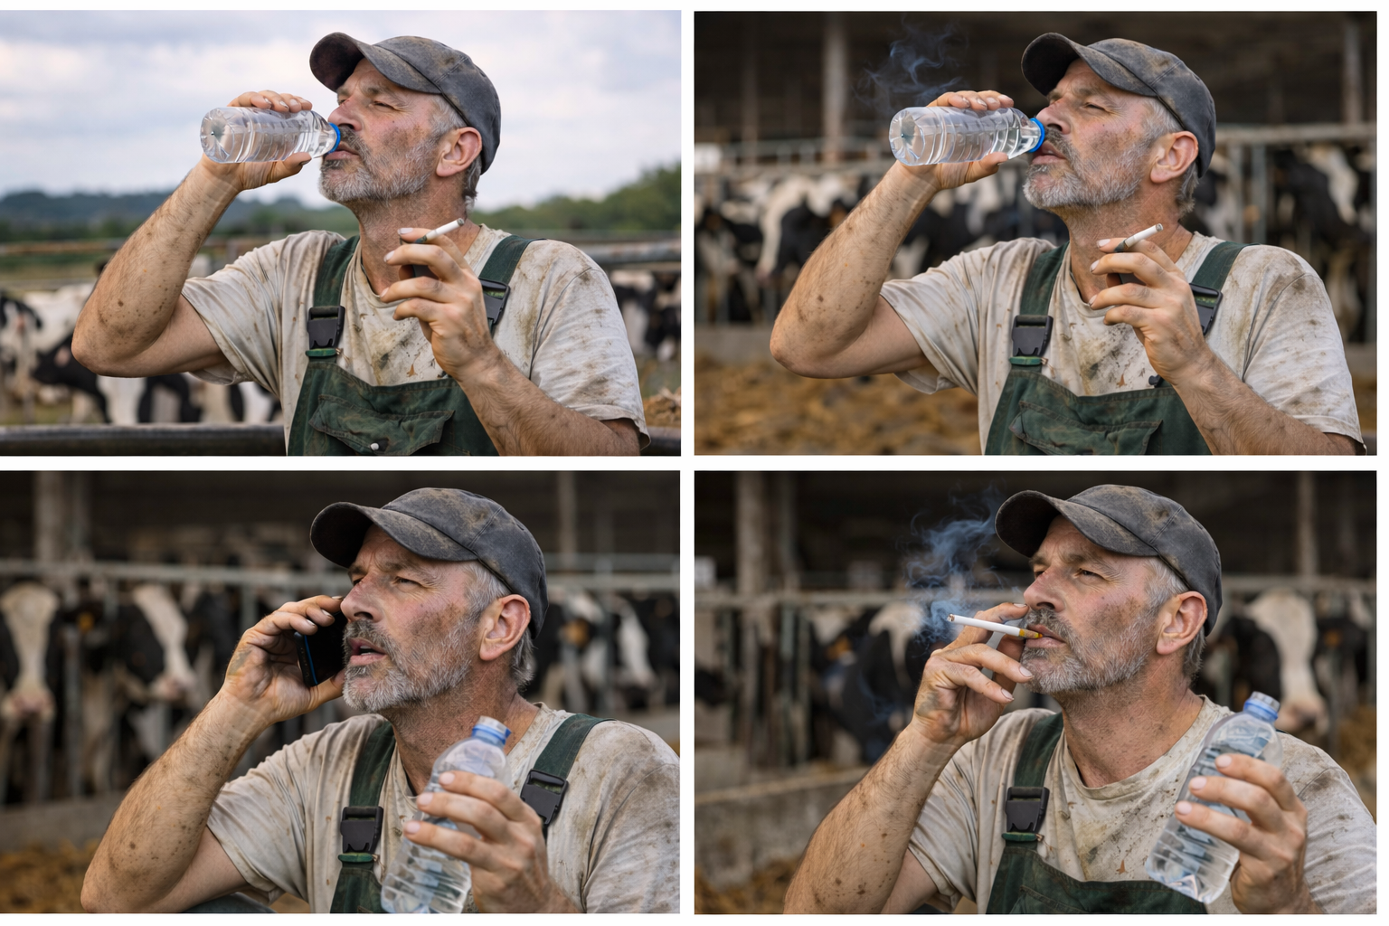
Transmission Routes : Ingestion
Taking a break at the dairy
Notes:
These are all activities that can increase the risk of ingesting a illness-causing pathogen

Slide 11
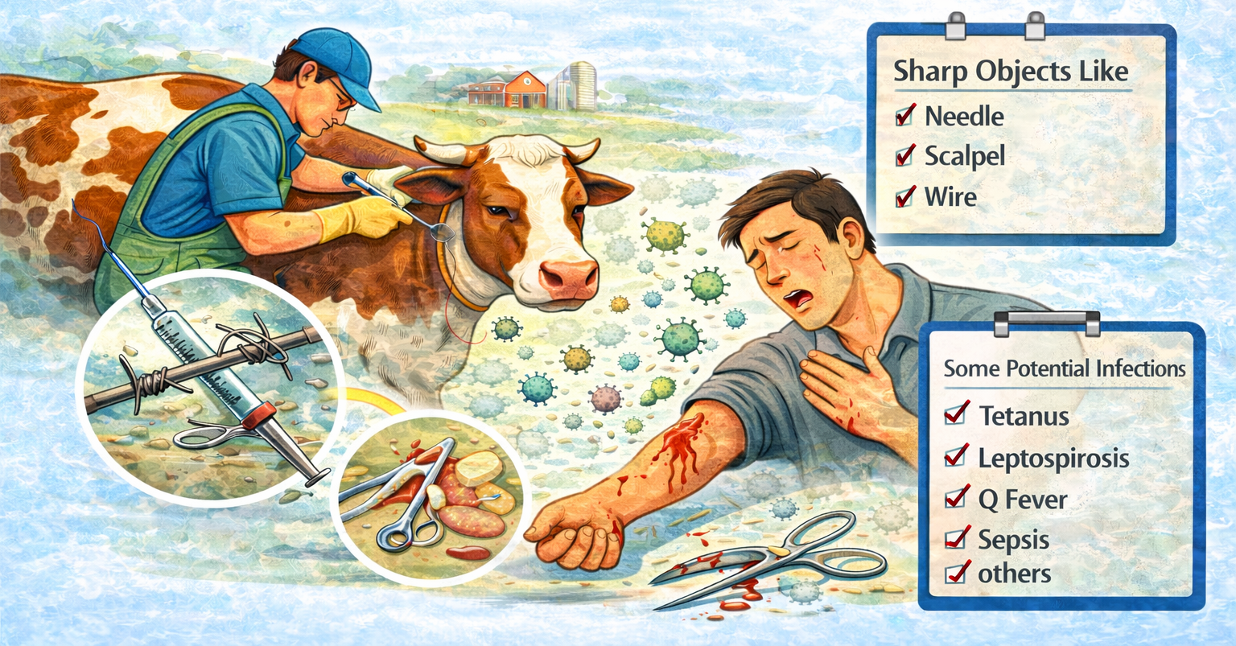
Transmission Routes : Sharps injuries
Reference: TTT Self-Guide Manual (Page 12-13)
Notes:
Sharp objects breaking skin is a possible transmission route for pathogens. This includes needle sticks, scalpel cuts or cutting the skin on sharp wire or metal.

Slide 12
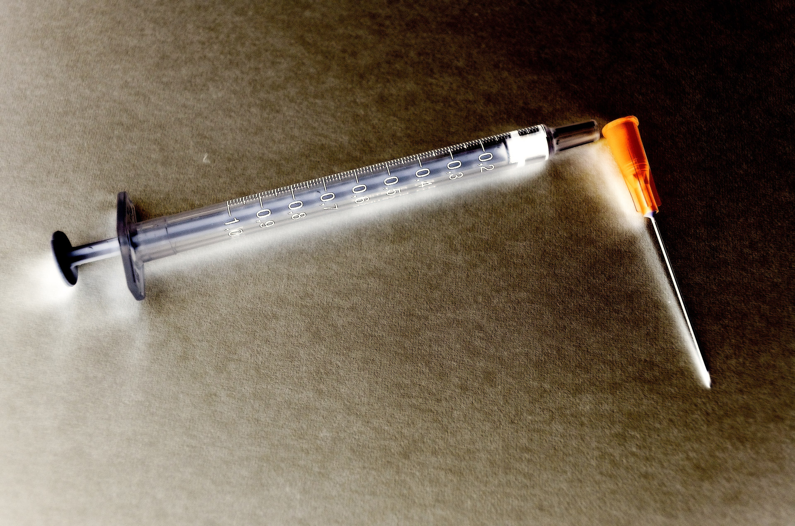
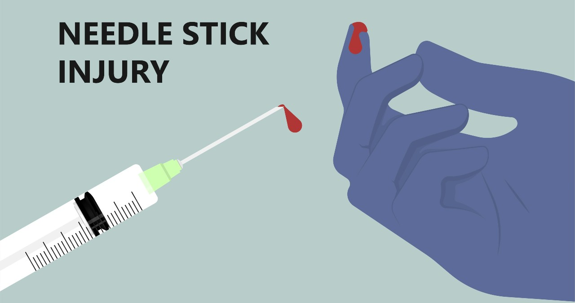
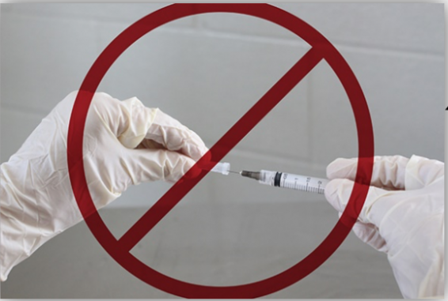
Transmission Routes : Sharps injuries
8 out of 10 dairy workers have accidentally poked themselves with a needle!
Notes:
8 out of 10 dairy workers have accidentally poked themselves with a needle!
As the audience “How many of you have been stuck by needles?”

Slide 13
RECAP- 5 modes of disease transmission
1. Direct contact
2. Indirect contact (fomites)
3. Airborne
4. Ingestion
5. Sharps
Notes:
As a recap, these are the five was diseases can be transmitted

Slide 14
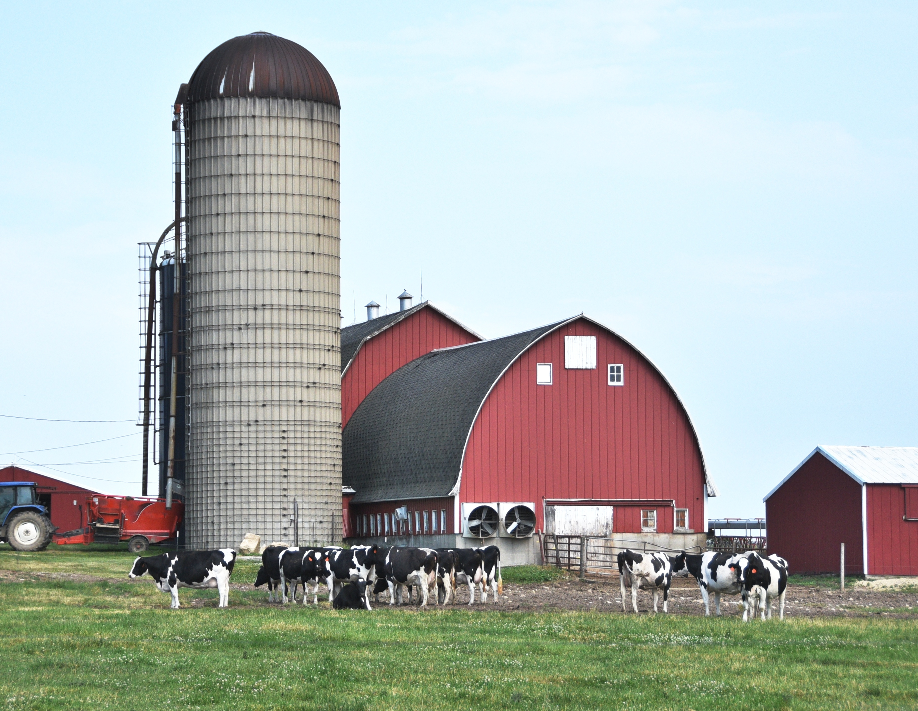
High-Risk Dairy Farm Tasks:
Milking
Injections, vaccinations, and needle use
Wound care and surgery
Handling and examining animals
Calving / birthing
Cleaning and sanitation, exposure to manure and waste
Working with and transporting dead animals
Insert drawing of a farm
Notes:
There can be a higher-risk areas of infection on dairy farms because of
- Contact with animals
Contact with and animal fluids
Contact with waste

