Slide 1
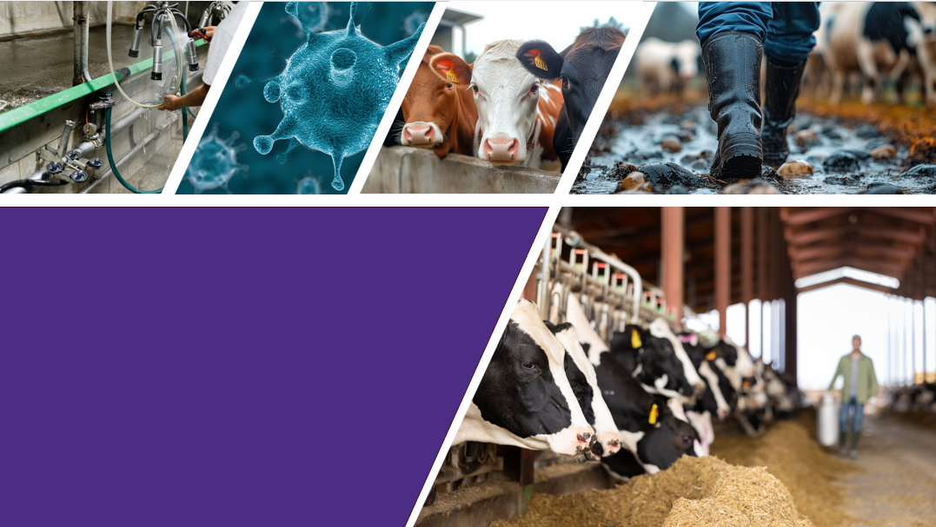
PROTECTING WORKER HEALTH
Infection Prevention & Control on Dairy Farms

Slide 2
Objectives
Recognize the importance of infection prevention and control on the farm.
Have a completed IPC Plan for the dairy
Notes:
The objectives of this training is to review the importance of infection prevention and control (IPC) on the farm, explain how germs are passed around in a farm setting, and how to minimize the risk of illness. As you go through this training, you will complete an IPC Plan to keep alongside your Biosecurity Plan on the farm.

Slide 3



Who We Are & Our History Working with Dairy Farms
2016-2022 Healthy Dairy Worker Study (PNASH)
2024-present IPC (L&I SHIP)
Collaboration with Northwest Dairy Association/Darigold
IPC plan & Training
Dairy Worker Health
Microbiome
2019-2021 IPC Online Training (UW CE)
Transitioned mid-activity to COVID-preparedness
2023 IPC with Producers
Surveys at DOSH Ag Safety Day
2013-2015 One Health Dairy Conversations
Discussions with producers about One Health approaches to Dairy
IPC Best Practices
Notes:
At the University of Washington, they have been partnering with dairies since 2013 to improve the health of workers and cows on the farm. We have developed training tools & resources for animal agriculture and have tested and evaluated solutions with partners.

Slide 4
Survey of Knowledge, Attitudes and Behaviors around Infection Prevention
Knowledge related to infectious diseases on the farm.
Personal protective equipment, handwashing, and needle safety practices
Barriers to infection prevention practices on the farm.
Notes:
They partnered with owners, managers, and workers and 5 Washington state dairy farms to conduct a Knowledge, attitude, and behavior survey to support us putting together this practical and effective guide to improve infection prevention and control on dairy farms.

Slide 5
What We've Learned from WA Dairies: Needs for IPC on Dairy Farms
Handwashing
PPE Use
Access challenging due to farm layout.
Varies by fit, comfort, heat, and task.
High-Risk Tasks
Needle Safety
Protection difficult with animal contact.
Sharps practices tough in field conditions.
Family Concerns
Training Needs
Germ transfer to family is a worry.
Dairy-specific training is essential.
Notes:
This is information from multiple projects we have had with dairy farms over the years.
We spoke with over 100 dairy workers and farm owners across Washington to learn more about infection prevention practices.
Here is a quick overview of our results:
Many workers had limited awareness of how diseases can spread between animals and people.
Use of PPE like eye protection and respirators was low, often because it was uncomfortable, hot, fogged up, or made tasks harder and were not always offered or readily available.
Workers may need more support with needle safety training and having sharps containers placed closer to them
Handwashing was common, but workers shared that stations were sometimes too far away and time was limited.
Many also talked about wanting to protect themselves and their families.
These findings show that effective infection prevention depends on having the right training, tools, access, and clear expectations. It is important to identify strategies for improving farm practices and not placing responsibility on individual workers alone.

Slide 6
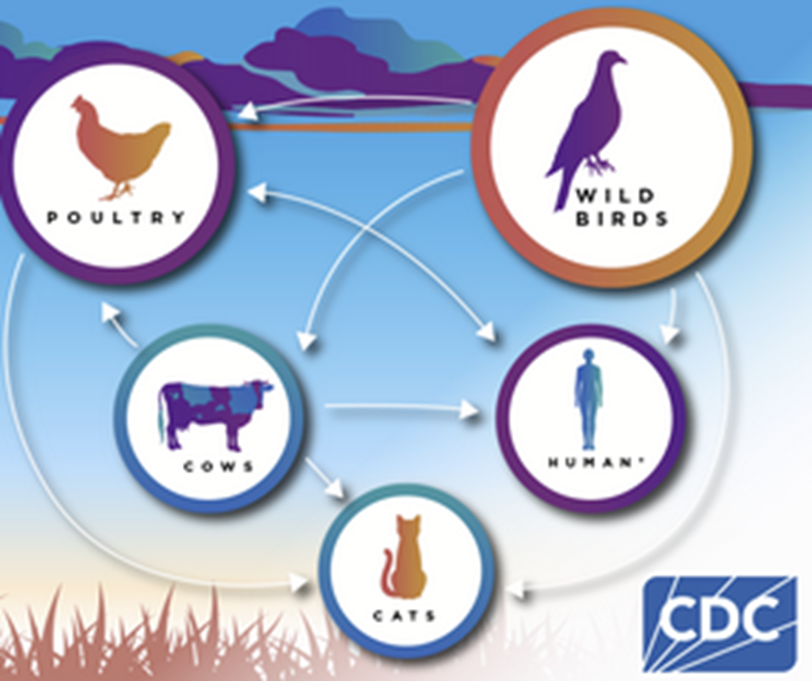
Prevention is Key
Notes:
In the case of avian influenza, we can see how diseases that can spread from wild animals, to farm animals, to humans, to domestic animals like cats. We see in the case with dairy the virus can spread through milk droplets in the air and these diseases can have negative financial impacts for the farm. This is why having standard practices in place to prevent infectious outbreaks from occurring is important to the health and well-being of everyone on the farm. And when a worker becomes sick from a pathogen this could negatively impact the worker, Coworkers, Animals, the farm and the community.

Slide 7
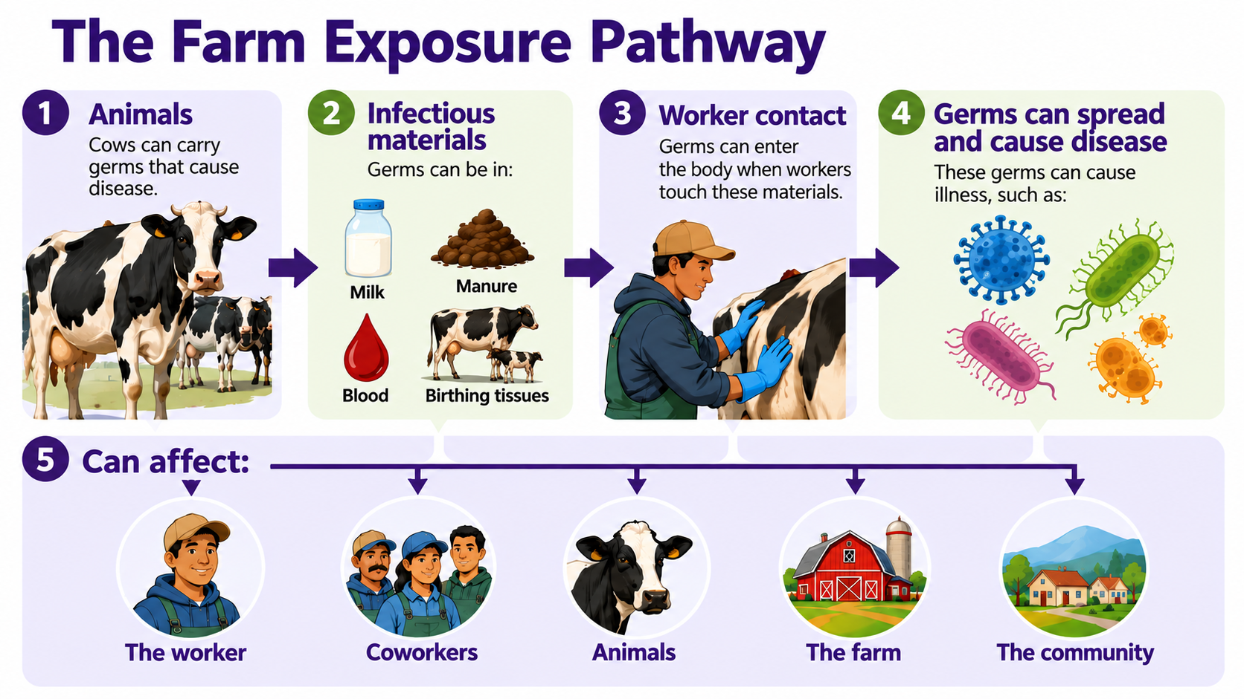
Notes:
Workers on dairies can be exposed to infectious pathogens at work including viruses, bacteria, and parasites. Some common pathogens on dairy farms are the ones found here. Exposure can occur through contact with cow milk, manure, blood, dust and birthing tissue. And when a worker becomes sick from a pathogen this could negatively impact the worker, Coworkers, Animals, the farm and the community.
Disclaimer: This image was made using artificial intelligence (ChatGPT)
In the interviews on dairy farms in Washington state, many of the workers did not think they could get cows sick and that cows could get them sick. This type of education on the farm can keep everyone healthy.

Slide 8
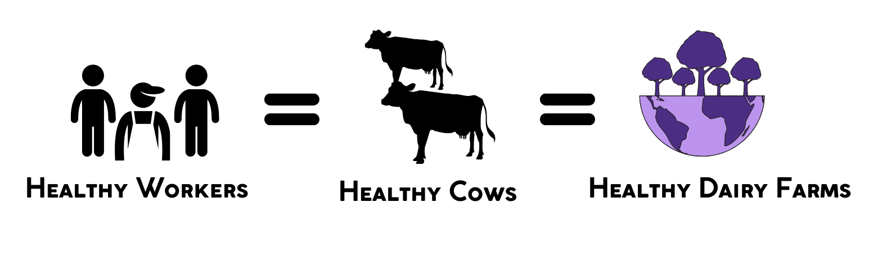
IPC & Productive Agriculture​
Ensures employee safety
Maintains herd health
Boosts productivity & food safety
When all are healthy, the entire farm thrives.
Notes:
When workers stay healthy, animals are more likely to stay healthy too. Creating a farm IPC team strengthens communication, encourages engagement, and builds shared responsibility for infection prevention and control.

Slide 9
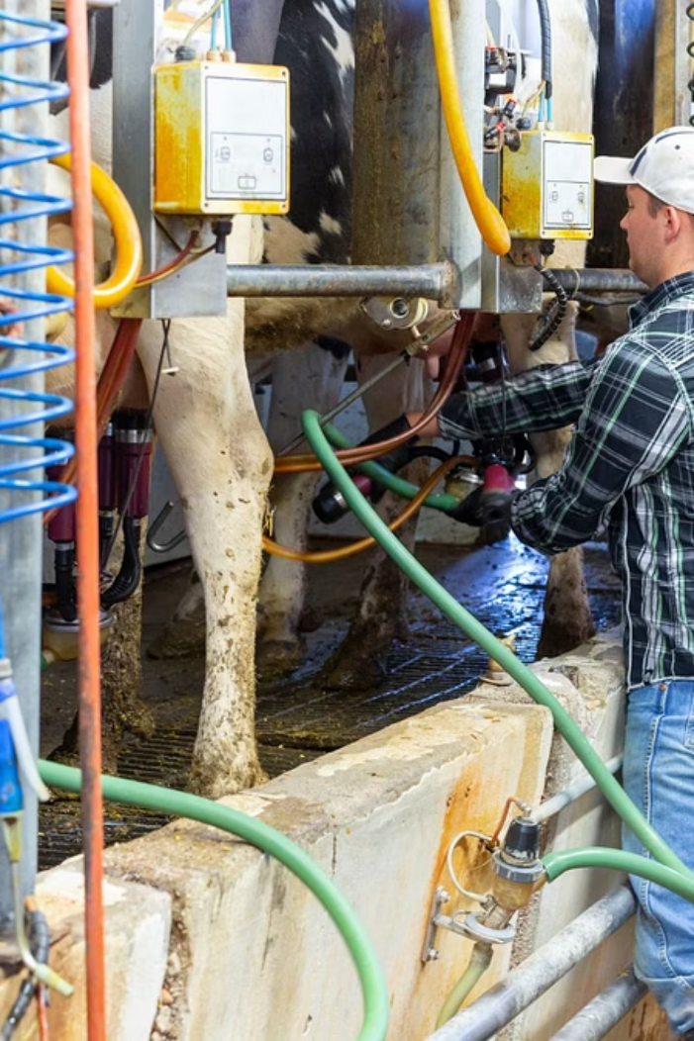
What is an Infection Prevention and Control Plan?
.
An Infection Prevention and Control (IPC) Plan is vital for dairy farms. It safeguards animal and human health, ensures safe milk, and maintains stable operations.
Notes:
An IPC Plan is a tool. It helps make expectations clear, especially during higher-risk tasks. For workers, it means clearer guidance, safer practices, and protection for your families. For the herd, it means fewer diseases spreading and healthier animals. And for the farm, it helps keep operations running smoothly, even during outbreaks
The IPC Plan is to be used as a supplementary module to other existing farm guidelines, such as a farm Biosecurity Plan and/or a farm Safety or Accident Prevention Plan. The adoption of the IPC Plan will aid in achieving regulatory compliance with Washington State’s L&I’s workplace safety and health laws but does not guarantee complete alignment.

Slide 10

IPC vs. Biosecurity Plans
Biosecurity Plan
IPC Plan
Focus: herd health
Prevents disease entry
Protects animals
Controls animal movement
Adds worker health
Prevents human disease
Protects workers & animals
Includes hygiene practices
IPC expands biosecurity, adding worker health to farm guidelines.
Notes:
An IPC Plan is a tool. It helps make expectations clear, especially during higher-risk tasks. For workers, it means clearer guidance, safer practices, and protection for your families. For the herd, it means fewer diseases spreading and healthier animals. And for the farm, it helps keep operations running smoothly, even during outbreaks
The IPC Plan builds on a farm’s biosecurity plans for protecting herd health with the important addition of worker health.
A good IPC plan includes practical steps to reduce the spread of germs between cows and people—and helps keep everyone on the farm healthy.
It also prepares the farm to act quickly in case of an outbreak.

Slide 11
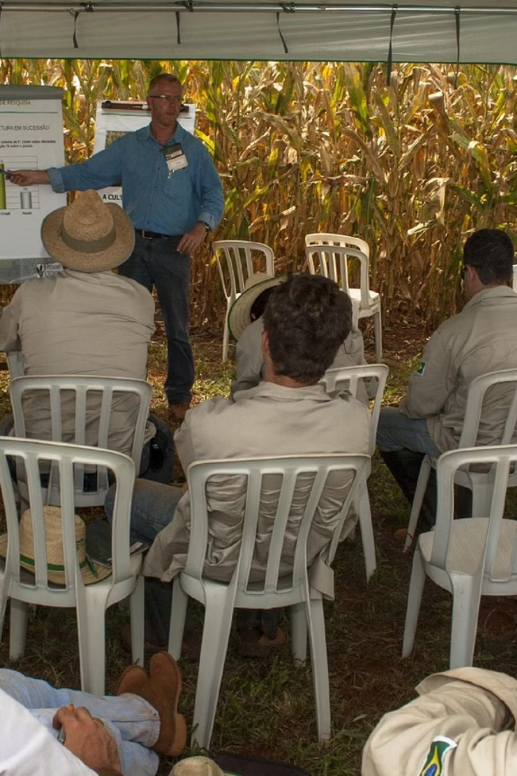
Culture: Key to Health, Safety & Well-being
Strong health and safety culture on a farm
drives effective infection prevention.
Notes:
The Role of Culture for Health, Safety, & Well-being
farm culture that values the health of both animals and workers.
This culture protects human and animal health, supports productivity, and ensures food safety.
It also helps reduce workplace injuries, prevent outbreaks, and improve economic sustainability.
A strong health and safety culture means everyone on the farm is trained, equipped, and encouraged to identify and report infectious hazards.
Routine practices—such as handwashing—can stop infections from spreading on and off the farm.
It is important for employees to feel safe to report safety hazards and infection concerns.

Slide 12
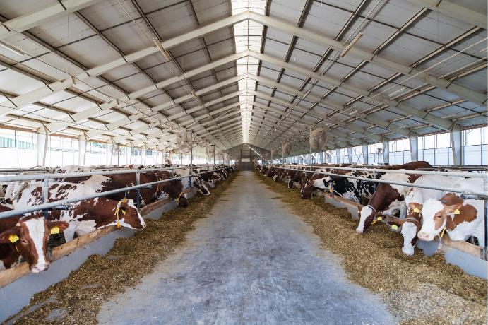
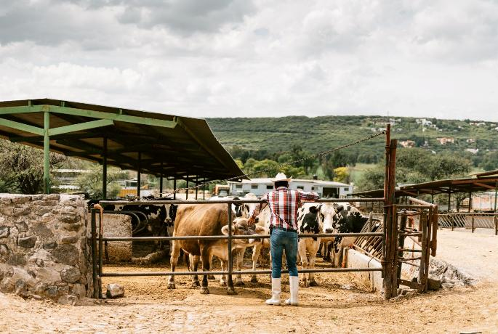
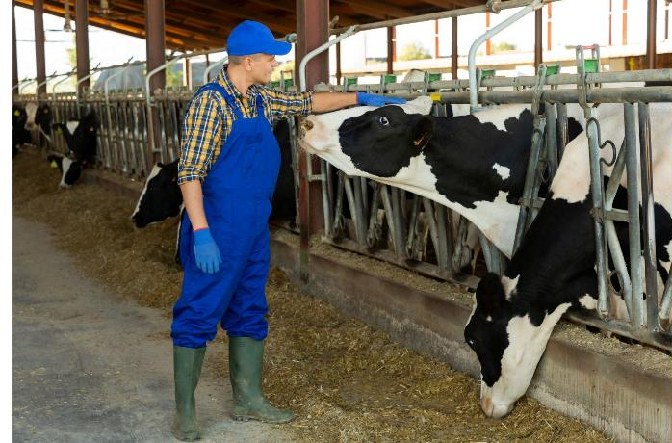
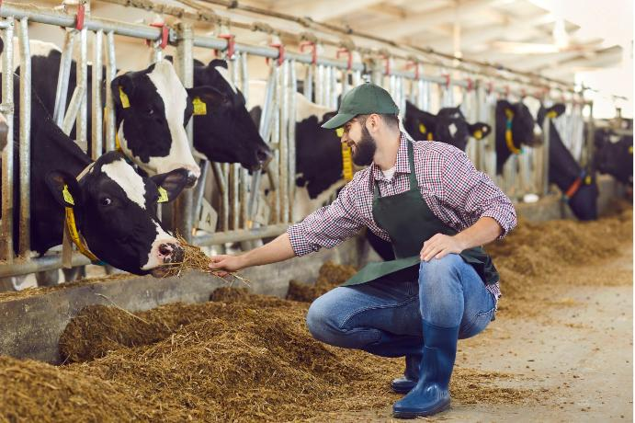
What does a healthy workplace culture mean to you?
Notes:
Group Discussion
When you hear: A strong culture of health and safety, what comes to mind for you?
What is the environment like?
What does communication look like?
Benefits of Health Workplace culture:
Strong Culture = Strong IPC Program
Protects Animal & Worker Health
Supports Productivity & Food Safety
Prevents Injuries & Disease Spread
Employees are Trained and Equipped
Routine Practices Stop Infections
Workers Feel Safe to Report Hazards & Concerns
A strong culture isn’t just a policy. it’s what people do every day and how supported they feel doing it.

Slide 13

Building a Culture of Health & Safety
More Than a Document
Leadership Commitment
IPC is part of how your farm operates every day
Management leads by example and prioritizes safety
Trust & Communication
Shared Responsibility
Open dialogue without fear of blame
Everyone plays a role in prevention
Notes:
Building a Culture of Health & Safety requires commitment from Management and Employees to commit to activities that help prevent infection in workers and cows.

Slide 14
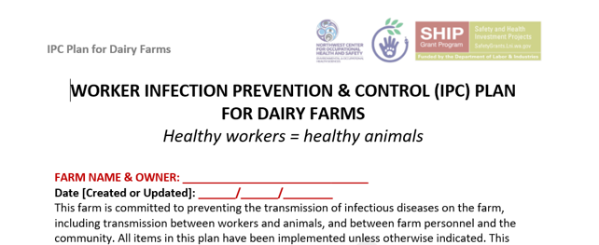
Your IPC Plan Draft
Notes:
If front of you, you will see the IPC Plan Draft that we will be working out of today. Throughout this training, we will be returning to this document and completing the form so that by the end of the training you will have a completed IPC Plan to put alongside the biosecurity plan

Slide 15
Your IPC Plan Draft
At the top of the IPC draft, write your farm’s name and owner name, as well as the date the plan is being created or updated at the top of Page 1.

Slide 16
PROTECTING WORKER HEALTH
Getting Started on Your Farm IPC Plan

Slide 17

The IPC Point Person
Purpose of This Role: Your go-to person for all things IPC
Qualities to Look For
Key Responsibilities
Familiar with farm operations
Understands zoonotic diseases
Trusted and approachable
Supports open communication
Maintains and updates the IPC plan
Communicates changes with workers
Answers employee questions
Addresses safety concerns
Notes:
The first step in fostering a culture of health on the farm is to designate a point-person. This person is responsible for implementing, maintaining and updating the Infection Prevention and Control (IPC) plan
This point-person should be:
familiar with farm operations,
knowledgeable about the hazards of zoonotic diseases (diseases that can be transmitted between animals and humans),
well-versed in the control methods in this IPC plan
trusted, approachable, and encourage open communication about ideas and questions about infectious diseases on the farm for employees.

Slide 18
The IPC Point Person
Purpose of This Role: Your go-to person for all things IPC
Qualities to Look For
Key Responsibilities
On Page 1 of the IPC Plan Template, write the name, email and phone number of the Point Person responsible for maintaining this IPC Plan and acting as a point of contact for employees.
Familiar with farm operations
Understands zoonotic diseases
Trusted and approachable
Supports open communication
Maintains and updates the IPC plan
Communicates changes with workers
Answers employee questions
Addresses safety concerns

Slide 19
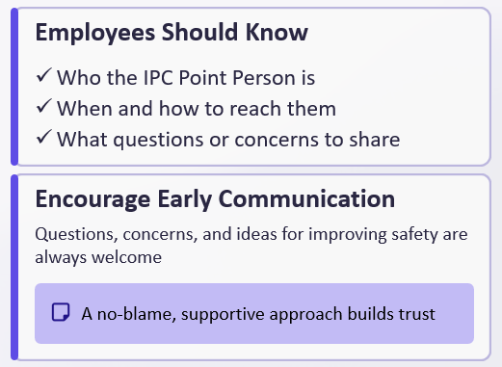
Employee and IPC Point Person Communication
Notes:
Employees should be encouraged to reach out to this person as needed

Slide 20
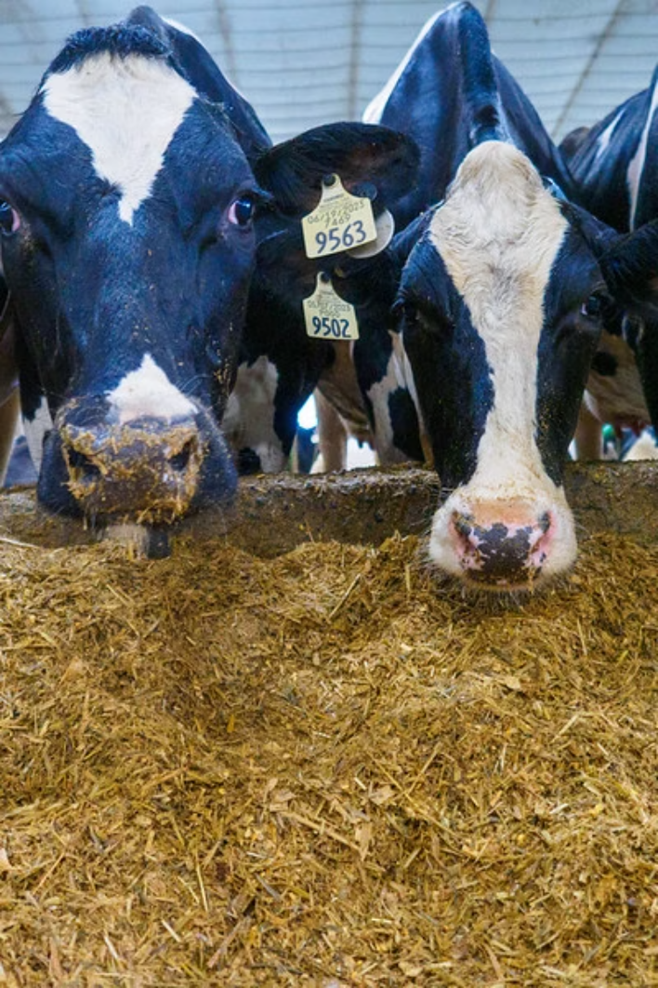
Shared Commitment
= Success
.
For IPC program success, everyone must work together. Managers and employees share responsibility for a safe work environment.
Notes:
IPC Program Shared Commitment
For an IPC program to succeed, everyone must work together. Managers and employees must share responsibility for creating a safe and healthy work environment. This shared commitment builds trust, improves communication, and keeps the program going over time.

Slide 21
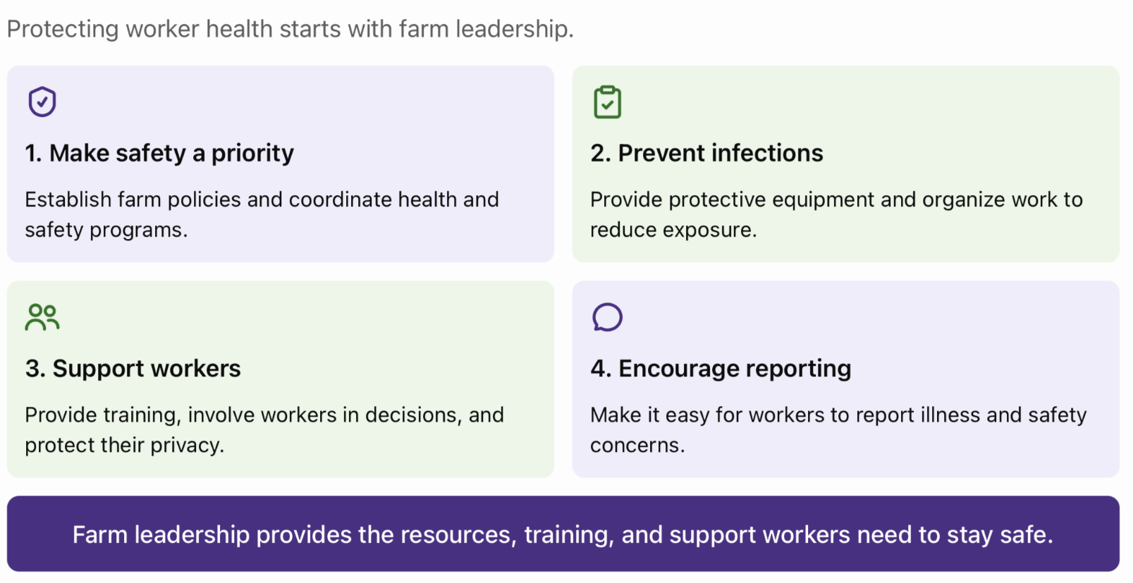
Farm Owner & Manager Responsibilities
Notes:
Farm owners and managers should show clear support for worker health and safety. Their leadership sets the tone for the whole farm.
Key actions include:
- Making employee health and safety a core part of farm policy.
- Implement appropriate infection control measures.
- Designing work to reduce risks and support wellness.
- Involving workers in planning and decision-making.
- Training employees in work policies, illness prevention, and reporting procedures.
- Protecting worker privacy.
- Connecting and coordinating systems to promote health and safety.

Slide 22
Employee Expectations
Follow Controls
Communicate Concerns
Use PPE and follow all exposure
controls as required
Report issues to management promptly
Attend Training
Protect Those Around You
Participate in all safety sessions
Keep yourself, coworkers, families, &
community safe
Know the Risks
Be aware of tasks with exposure to disease
Notes:
Employees play an essential role in infection prevention. For an IPC plan to work, employees need to:
- Follow all exposure controls, work practices and personal protective equipment (PPE) expected on the farm.
- Attend/participate in all required trainings.
- Be aware of areas and tasks where there is a risk of exposure to infectious diseases from animals or co-workers and communicate concerns to management.
- Understand responsibilities for communicating concerns to management.
- Protect themselves, coworkers, families, and the community by following IPC guidelines.

Slide 23
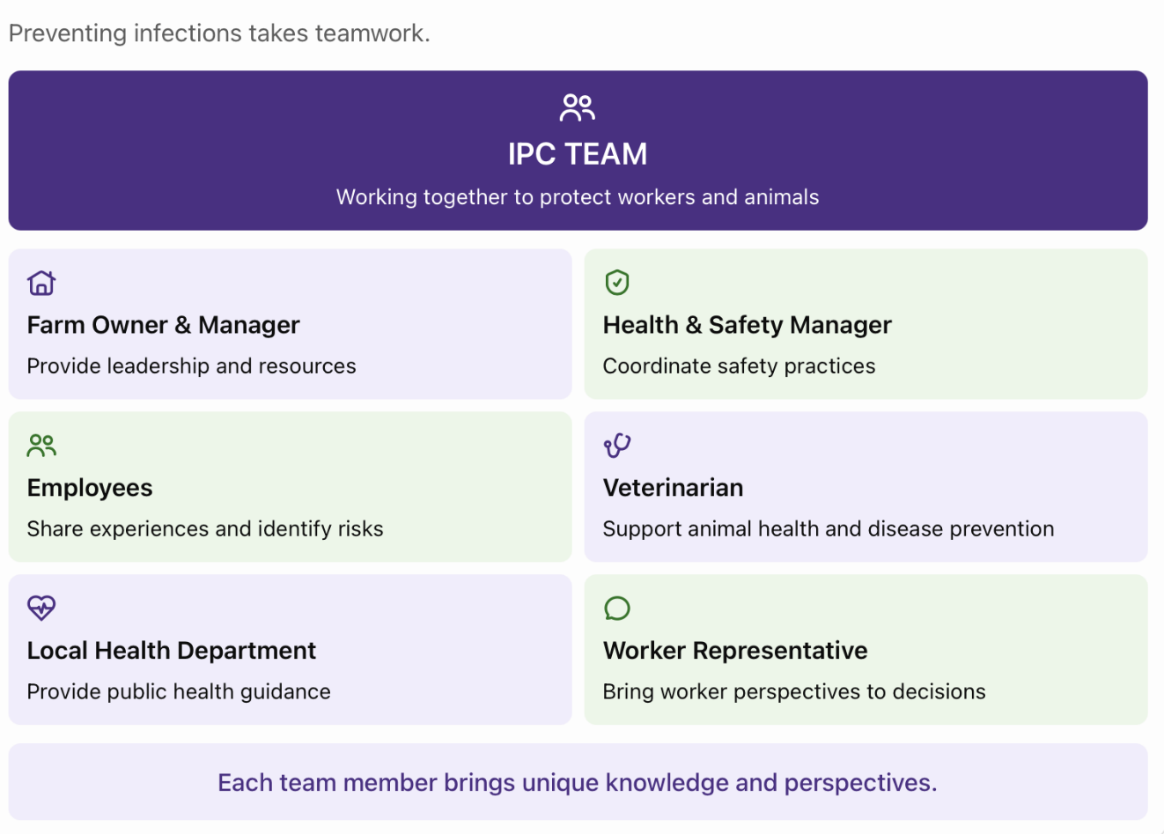
IPC Team & Cross-Disciplinary Collaboration
Notes:
The next step will be to create and IPC Team on the farm. Everyone on the farm should understand what the IPC Team is doing and why. This team brings together individuals with different roles and expertise to focus on protecting worker health. A dedicated IPC Team that includes worker health, herd health, and employee representatives will improve communication and promote collaboration across the farm. The team should also adapt their messaging to fit the needs of different audiences and ensure all communication reflects the farm’s health and safety values.

Slide 24
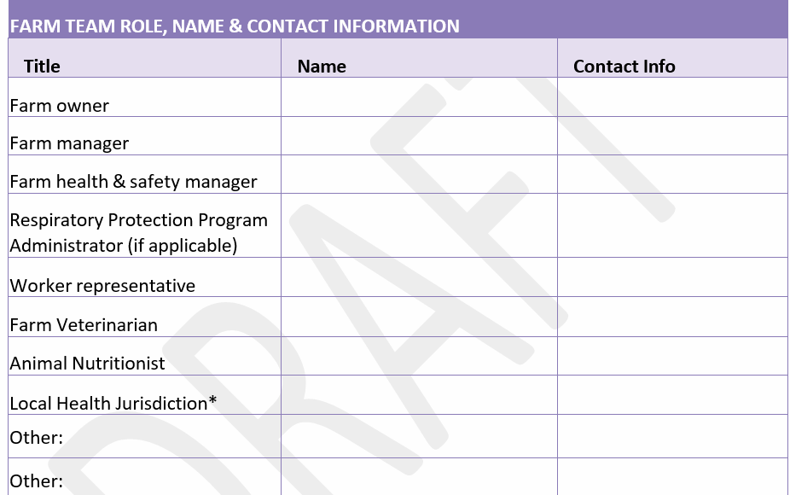
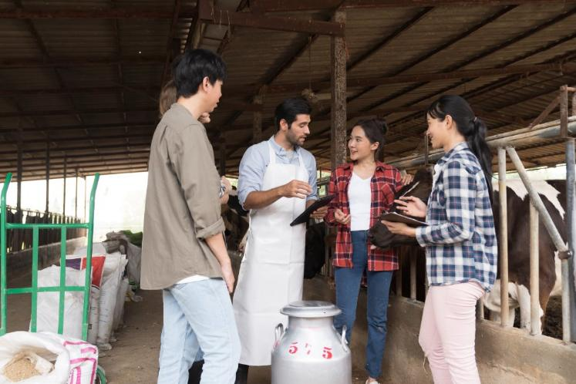
Creating Infection Prevention and Control Teams
Notes:
Everyone on the farm should understand what the IPC Team is doing and why. This team brings together individuals with different roles and expertise to focus on protecting worker health. A dedicated IPC Team that includes worker health, herd health, and employee representatives will improve communication and promote collaboration across the farm. The team should also adapt their messaging to fit the needs of different audiences and ensure all communication reflects the farm’s health and safety values. There is a link in the IPC plan to where you can find that the contact information for your local health jurisdiction

Slide 25
Creating Infection Prevention and Control Teams
On Page 2 of the IPC Plan Template, identify the IPC Team, including names, contact information and responsibilities.

Slide 26
PROTECTING WORKER HEALTH
Infection Transmission

Slide 27
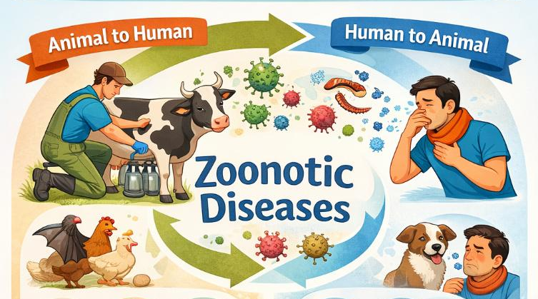
Zoonotic Diseases
There are over 200 zoonotic diseases worldwide.
Zoonotic diseases (zoonoses) are diseases that can be transmitted between animals and people.
60% of known infectious diseases of people are zoonotic.
Zoonotic diseases are an important health risk and concern for people and animals.
Mos zoonotic diseases can be avoided with proper prevention measures.
Source: CFSPH – Zoonotic Diseases
Notes:
Before we talk about evaluation, we are going to talk about infection and transmission…

Slide 28
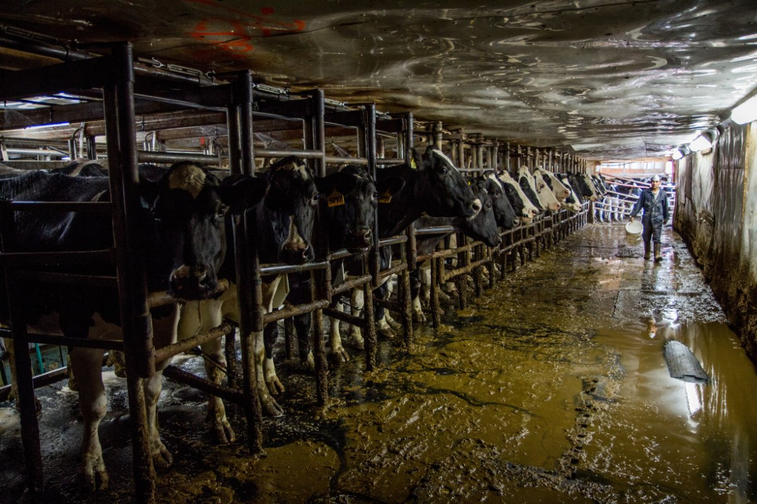
Types, Sources, and Examples of Infections
Diarrhea-causing pathogens
Respiratory infections
Skin/soft tissue infections
Sharps-related infections
Notes:
Examples of the types of infections that are found on dairy farms include diarrhea-causing pathogens, respiratory infections, skin and soft tissue infections and needle stick injuries.

Slide 29
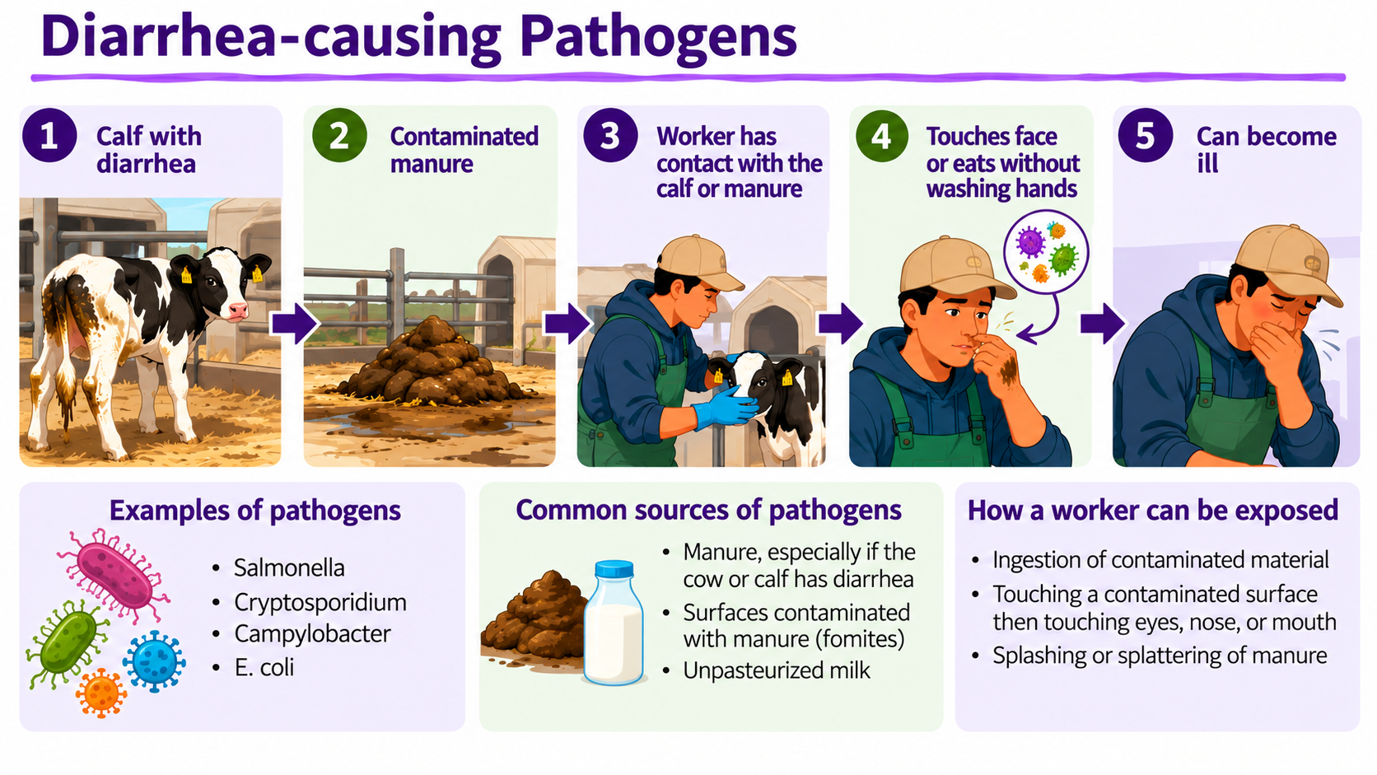
Notes:
This slide discusses diarrhea-causing pathogens, their sources and how workers on the farm can be exposed
Note: The graphic in this slide was made with the help of artificial intelligence (ChatGPT)

Slide 30
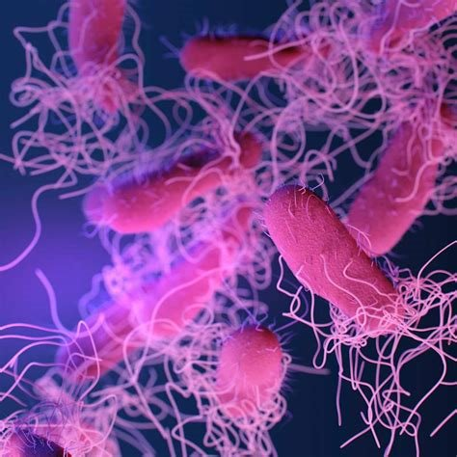
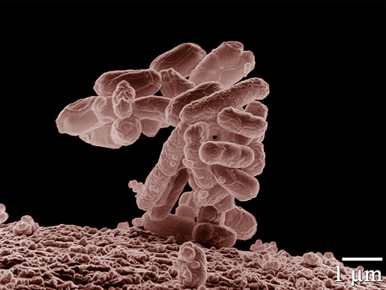
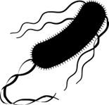
Diarrhea- causing Pathogens
E. coli
Reference: TTT Self-Guide Manual (Page 14)
Salmonella
Notes:
These are the pathogens for Salmonella and E. coli

Slide 31
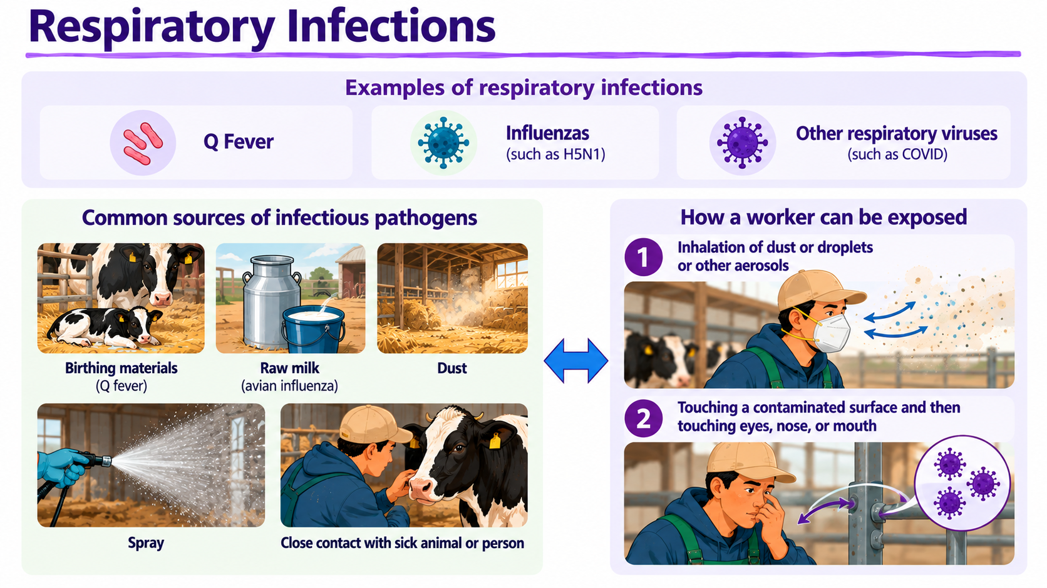
Notes:
This slide discusses the causes of respiratory infections, their sources and how workers on the farm can be exposed
Note: The graphic in this slide was made with the help of artificial intelligence (ChatGPT)

Slide 32
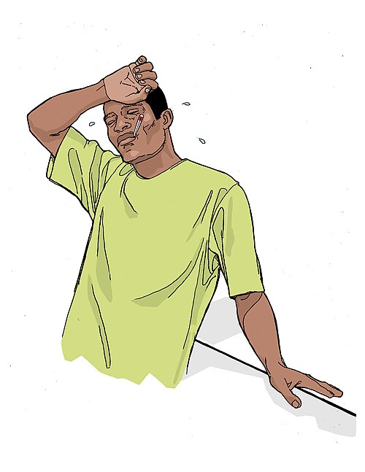
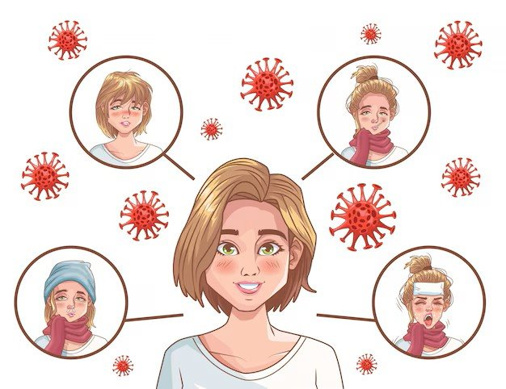
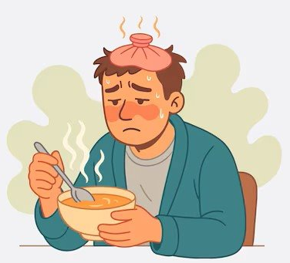
Respiratory Infections
Flu
Fever
Covid-19
Notes:
These are some illnesses and symptoms of respiratory infections

Slide 33
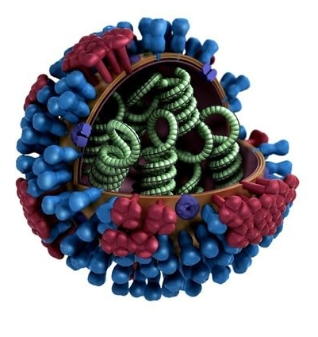
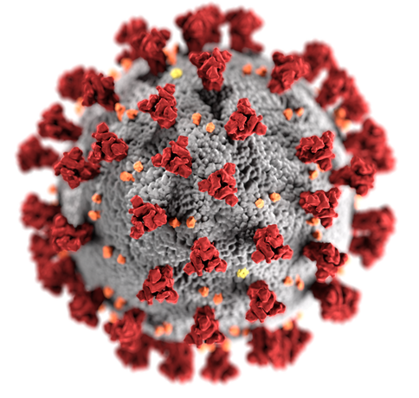
Respiratory Infections
Covid-19 virus
Avian influenza virus
Notes:
Some common respiratory infections that can be found on dairy farms include Covid-19 and Avian influenza

Slide 34
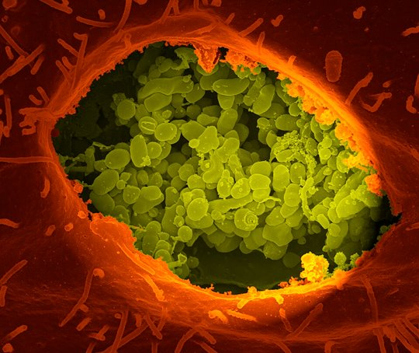
Respiratory Infections
Q fever (Coxiella burnetii)
Source: National Institutes of Health (NIH)
Reference: TTT Self-Guide Manual (Page 14)
Notes:
And Q fever, an pathogen that can cause a lot of acute illness and can lead to miscarriage or fetal death in pregnant women.

Slide 35
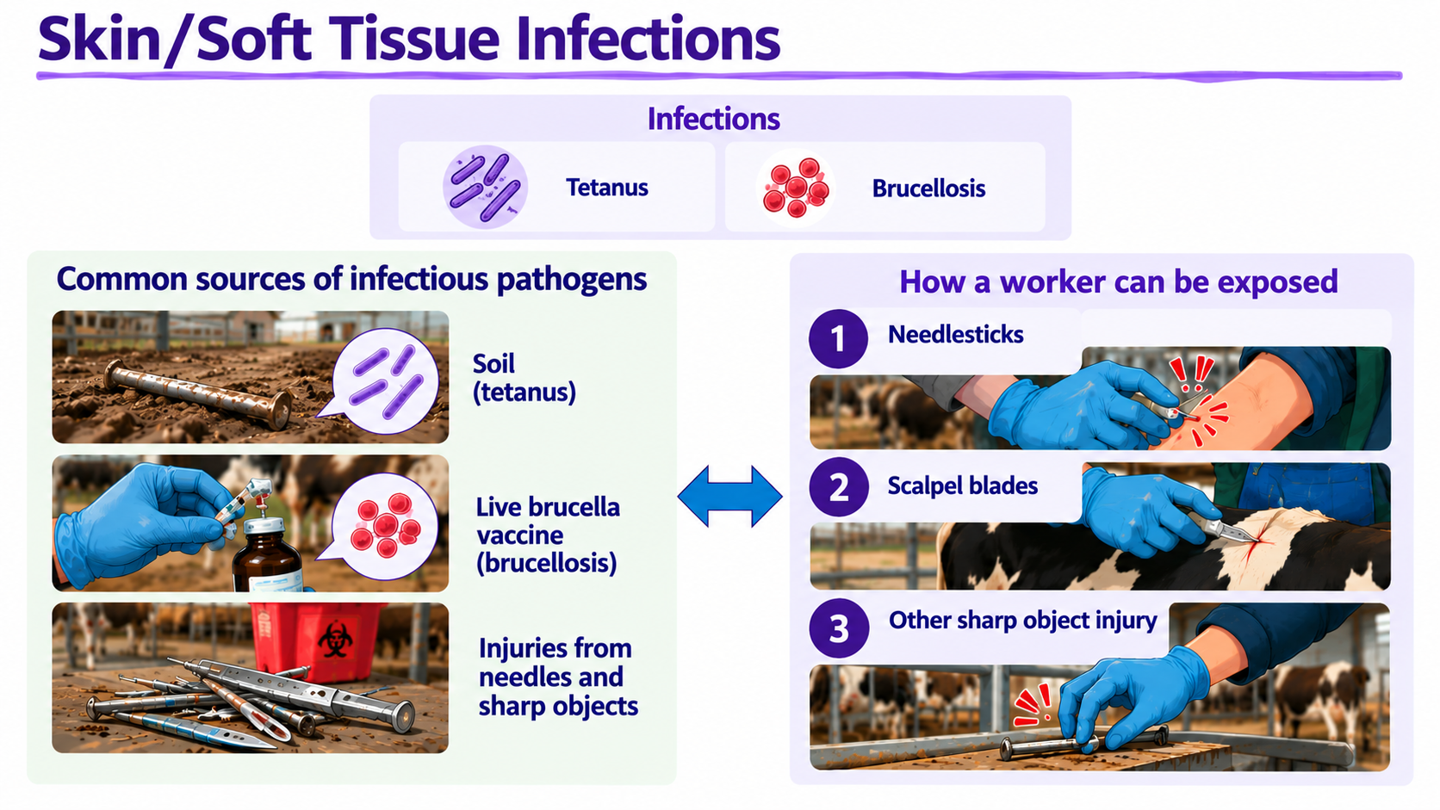
Notes:
This slide discusses the causes of skin and soft tissue infection, their sources and how workers on the farm can be exposed
Note: The graphic in this slide was made with the help of artificial intelligence (ChatGPT)

Slide 36
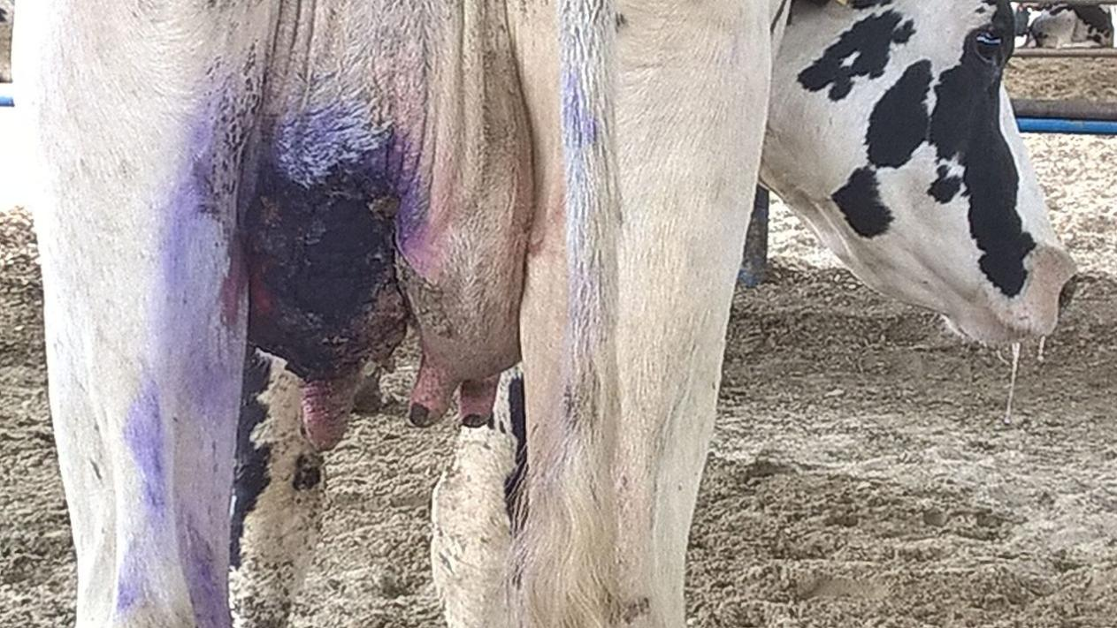
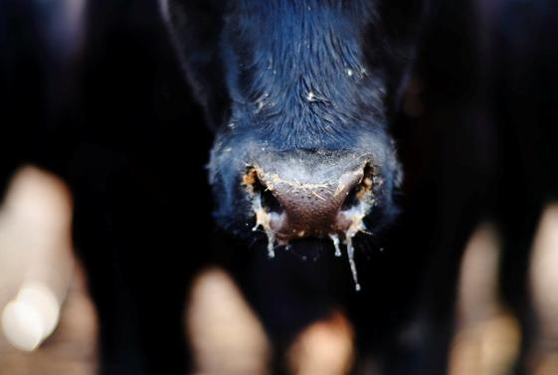

Skin/soft Tissue Infections
Dairy cow with gangrenous mastitis
Photo by Mohammad Golkar
Staphylococcus aureus
Source: U. S. Department of Agriculture
Reference: TTT Self-Guide Manual (Page 14)
Notes:
These include infections like mastitis and Staphylococcus aureus.

Slide 37
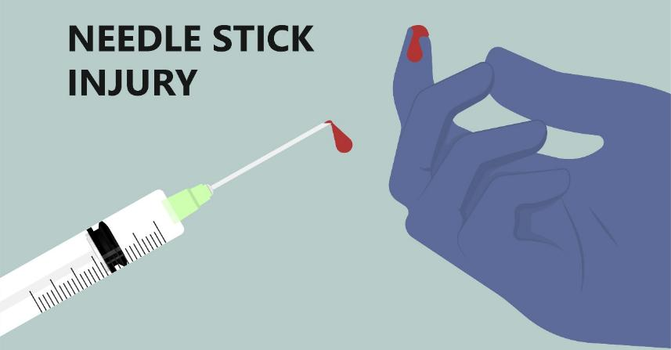

Sharps-related Infections
Scalpel blades​
Notes:
Needle sticks and cuts are a common occurrences in animal agriculture

Slide 38
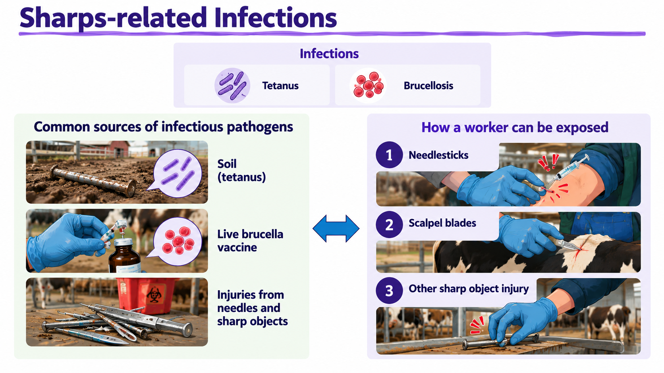
Reference: TTT Self-Guide Manual (Page 14)
Notes:
These injuries can lead to infections such as tetanus and brucellosis
Note: The graphic in this slide was made with the help of artificial intelligence (ChatGPT)

Slide 39

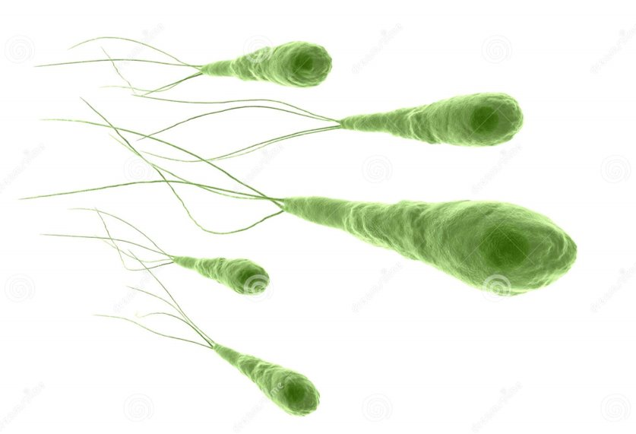
Sharps-related Infections
Tetanus (Clostridium tetani)
Brucella bacteria
Notes:
Symptoms cause by brucellosis in humans are similar to those cause by flu.
Tetanus is a serious disease of the nervous system caused by a toxin-producing bacterium. The disease causes muscle contractions, particularly of your jaw and neck muscles. Tetanus is commonly known as lockjaw. Signs and symptoms of generalized tetanus include:
Painful muscle spasms and stiff, immovable muscles (muscle rigidity) in your jaw
Tension of muscles around your lips, sometimes producing a persistent grin
Painful spasms and rigidity in your neck muscles
Difficulty swallowing
Rigid abdominal muscles

Slide 40
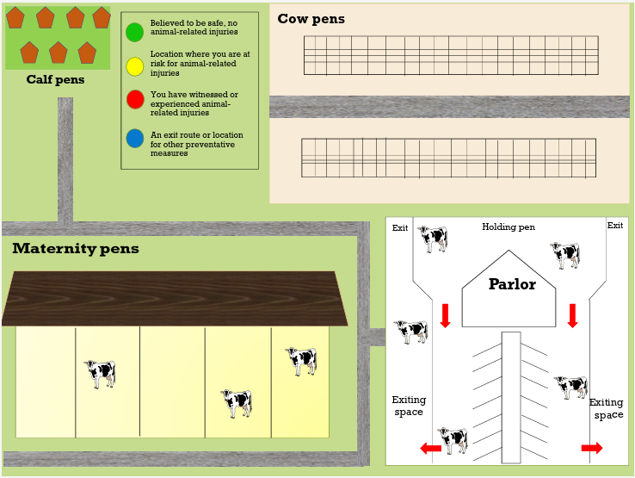
NO risk of infection
LOW risk of infection
MEDIUM risk of infection
HIGH risk of infection
Notes:
You can do an activity with the farm employees to learn about where they have concerns about health and safety.
Draw the dairy in a big paper and tape it on the one wall of easier access for the workers.
Give colored dots to the workers, staring with color green (no risk of infection).
Ask them to stand up and go to the drawing.
Ask them to paste the appropriate dot color (one color at time) where they consider risk of infection for them is:
No risk
Low risk
Medium risk
High risk
Wrap up and discuss. Take a picture of the drawing with the dots. Create plans to make those areas safer

Slide 41
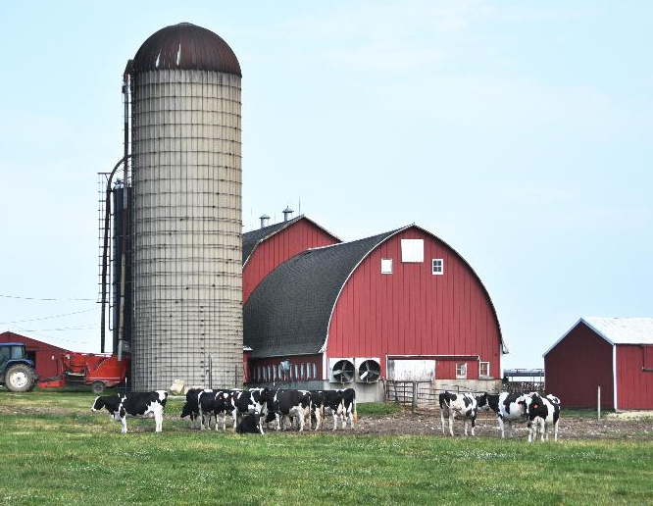
High-Risk Dairy Farm Tasks:
Milking
Injections, vaccinations, and needle use
Wound care and surgery
Handling and examining animals
Calving / birthing
Cleaning and sanitation, exposure to manure and waste
Working with and transporting dead animals
Insert drawing of a farm
Notes:
There can be a higher-risk areas of infection on dairy farms because of
- Contact with animals
Contact with and animal fluids
Contact with waste

Slide 42
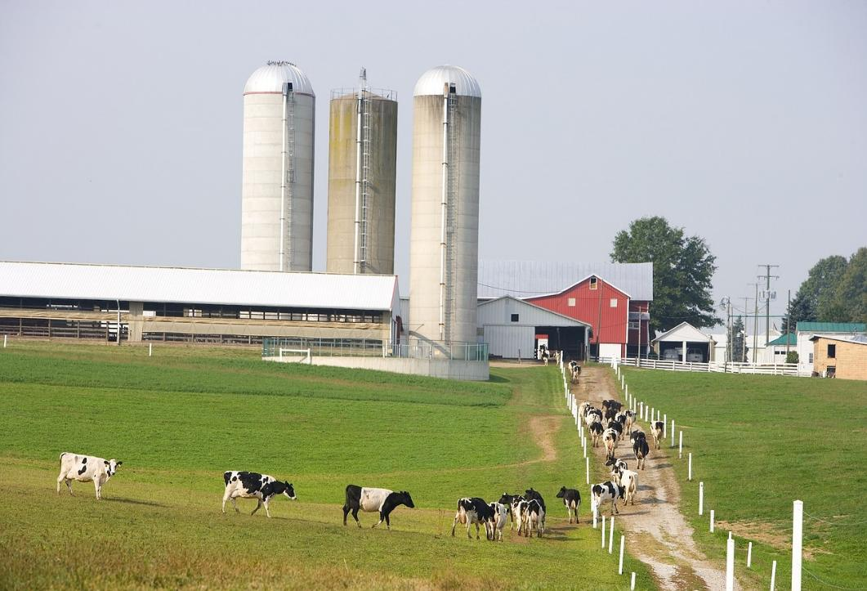
Transmission Routes for Diseases on Dairy Farms
There are five common routes of transmission:
1. Direct contact
2. Indirect contact (fomites)
3. Airborne
4. Ingestion
5. Sharps
Notes:
There are five common routes of disease transmission. Some pathogens are passed through multiple routes at once.

Slide 43
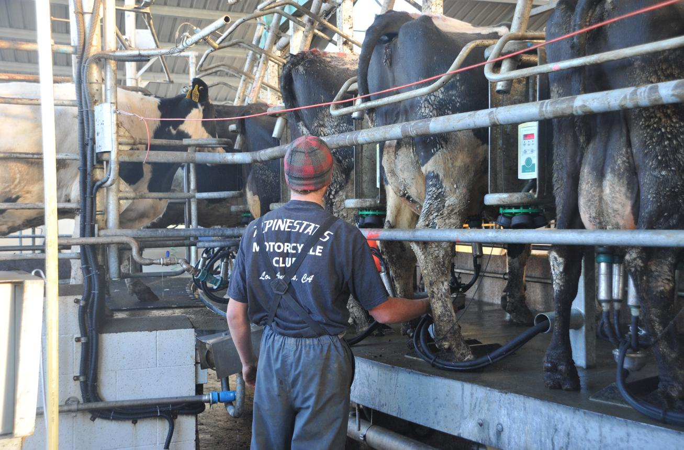
Transmission Routes : Direct Contact
Touching infected animals, their waste or bodily fluids.
Notes:
Direct contact includes touching infected animals, their waste, or bodily fluids
Examples: A worker assists with calving and gets amniotic fluid in an open cut.
Ask the audience for other examples.

Slide 44
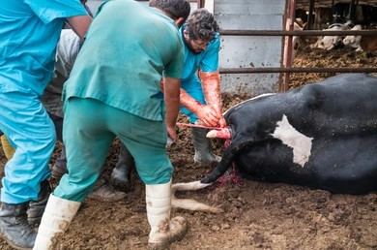
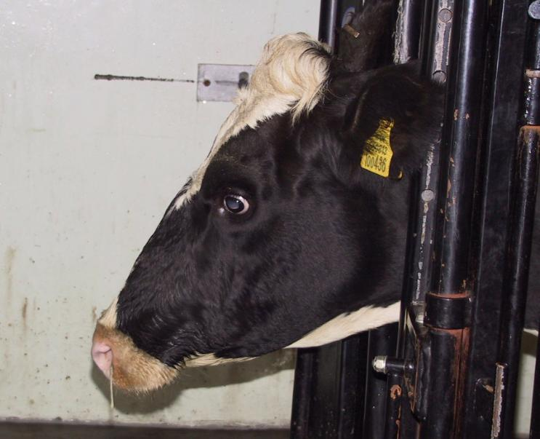

Transmission Routes : Direct Contact
Reference: TTT Self-Guide Manual (Page 12-13)
Notes:
Direct contact includes touching infected animals, their waste, or bodily fluids
Example: A worker assists with calving and gets amniotic fluid in an open cut
Ask for other examples

Slide 45
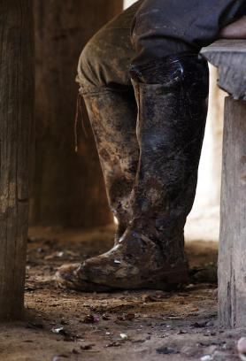
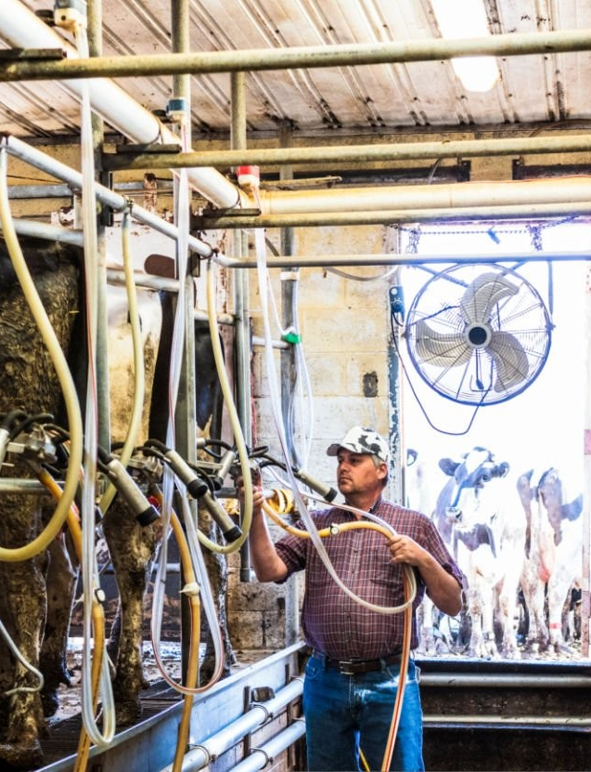
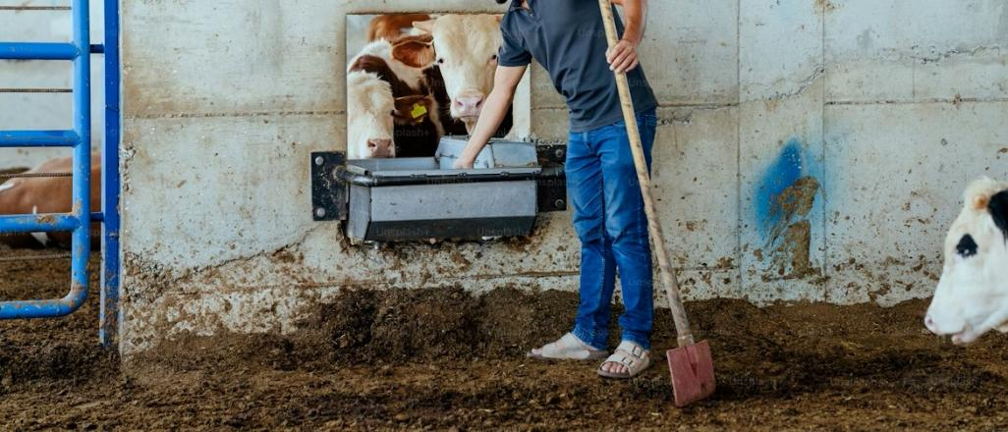
Transmission Routes : Indirect Contact
Touching contaminated objects or surfaces.
Notes:
Indirect contact includes touching contaminated objects or surfaces. These areas are called “fomites”
Example: Milking equipment contaminated with manure is touched and then the worker rubs their eye
Images of door knobs, milking equipment, microwaves, faucets

Slide 46
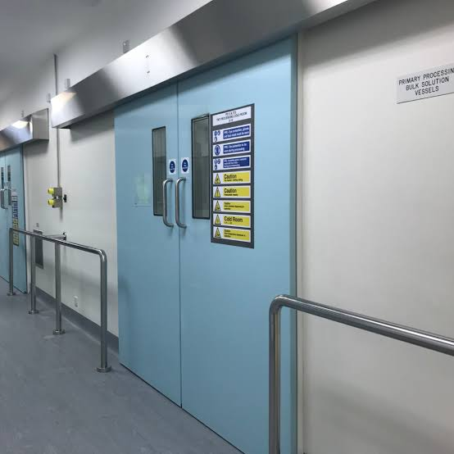




Other fomites include…
Breakroom Microwaves
Cell Phones
Doors (with handles, knobs or push)
Breakroom faucet handles
Notes:
Fomites can also be things that people touch throughout the day. And if hands aren’t clean when they are touched, they can be places where pathogens are transmitted.

Slide 47
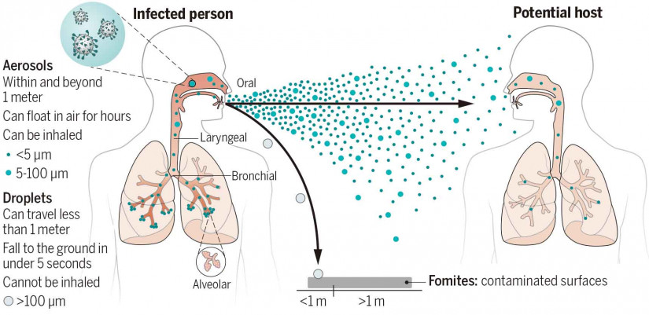
Transmission Routes : Airborne
Reference: TTT Self-Guide Manual (Page 12-13)
Notes:
Airborne transmission, the inhalation of Aerosols or Dust, includes breathing infectious particles suspended in air.
Example: Inhaling dust in a barn with Q fever

Slide 48
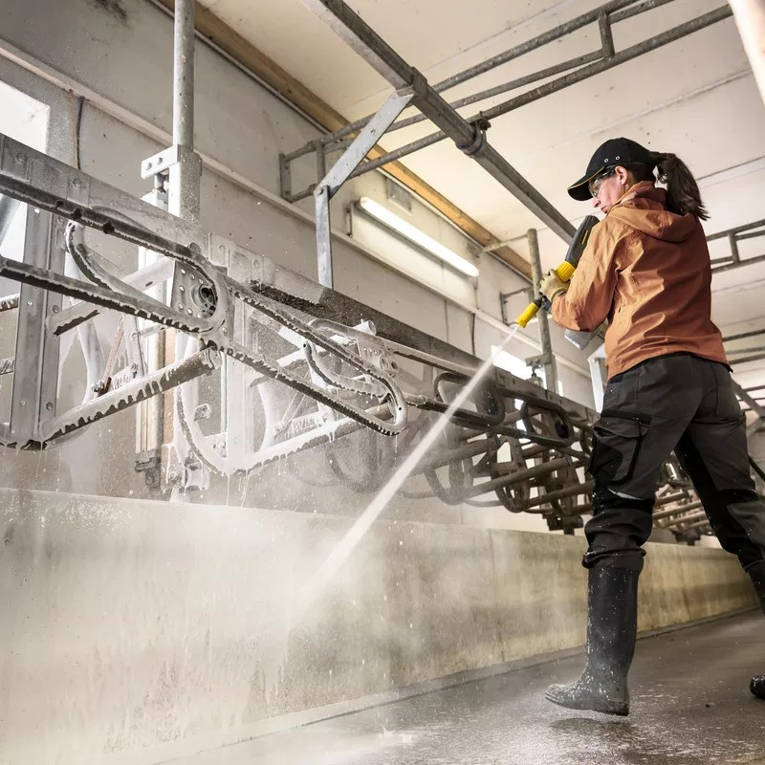
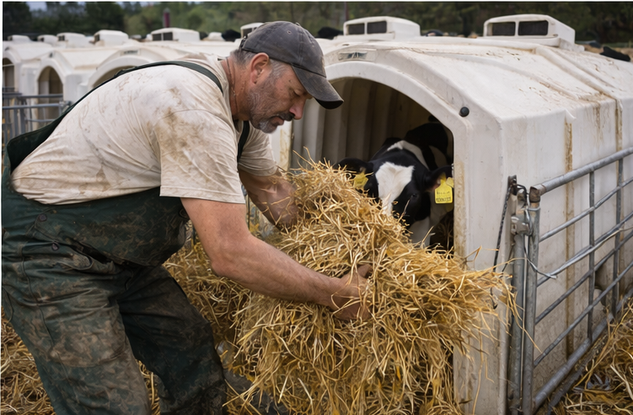
Transmission Routes : Airborne
Notes:
Particles can be accelerated through the air by spray or fans in the environment, or through moving dusty items.

Slide 49
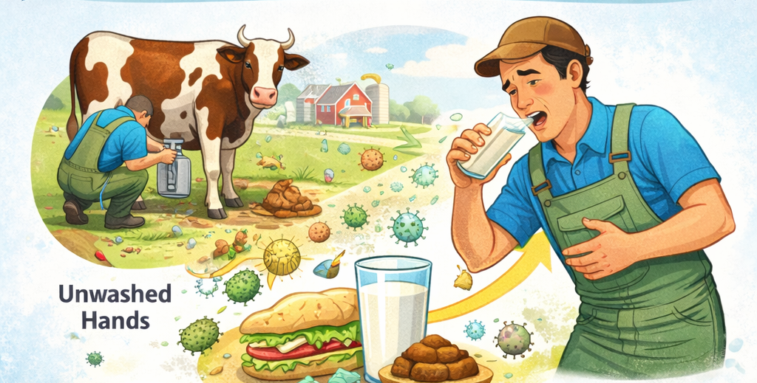


Transmission Routes : Ingestion
Ingesting contaminated food, water or transmitted by unclean hands
Notes:
Ingestion includes swallowing contaminated food or water or transmitted by unclean hands to the mouth.
Example: A worker eats lunch without washing hands after handling calves with diarrhea.

Slide 50

Transmission Routes : Ingestion
Taking a break at the dairy
Notes:
These are all activities that can increase the risk of ingesting a illness-causing pathogen

Slide 51

Transmission Routes : Sharps injuries
Reference: TTT Self-Guide Manual (Page 12-13)
Notes:
Sharp objects breaking skin is a possible transmission route for pathogens. This includes needle sticks, scalpel cuts or cutting the skin on sharp wire or metal.

Slide 52



Transmission Routes : Sharps injuries
8 out of 10 dairy workers have accidentally poked themselves with a needle!
Notes:
8 out of 10 dairy workers have accidentally poked themselves with a needle!
As the audience “How many of you have been stuck by needles?”

Slide 53
RECAP- 5 modes of disease transmission
1. Direct contact
2. Indirect contact (fomites)
3. Airborne
4. Ingestion
5. Sharps
Notes:
As a recap, these are the five was diseases can be transmitted

Slide 54
PROTECTING WORKER HEALTH
Hazard Assessment for Infections on the Farm

Slide 55


Using the Hazard Assessment Checklist
Each task has a checklist specific to it for identifying sources, controls, and PPE recommendations.
Check the box(es) that applies
Have the “Infectious Disease Hazard & Controls Assessment Checklist” nearby.
Notes:
The IPC Hazard Assessment Checklist covers the following important information for your farm:
High Risk Tasks
Transmission routes/sources
Transmission examples
Types of infections
Controls
PPE Recommendations

Slide 56

The Hierarchy of Controls
Five levels of protection for infectious agents.
Notes:
A key part of IPC is to apply prevention and precautions in order to reduce the risk of exposure. The Hierarchy of Controls helps farms choose the most effective ways to reduce infection risks. Many dairies already use these controls for safety. The IPC Plan builds on what’s already happening on the farm.
Strong prevention relies on design, practices, and planning and not just individual behavior. This framework helps farms decide which protections to include and where to focus efforts.

Slide 57

Notes:
QUICK hierarchy of controls top 3

Slide 58
Using the Hazard Assessment Checklist
Each task has a checklist specific to it for identifying sources, controls, and PPE recommendations.
Check the box(es) that applies
Notes:
This is the IPC Hazard Assessment Checklist. The checklist covers the transmission routes/sources, transmission examples, types of infections, different types of infection prevention controls and PPE recommendations for High-Risk Tasks on the farm. The tables on the slide are for the milking and vaccination tasks, but you will see in the packet that the assessment covers all high-risk areas on the farm.

Slide 59
Using the Hazard Assessment Checklist
Use the 'Other' to Add information not included on this list that applies to your farm
Notes:
On the form, there are locations to add other risks or other controls on the farm that are not listed above.

Slide 60
Using the Hazard Assessment Checklist
Use the 'Other' to Add information not included on this list that applies to your farm
Complete the “Infectious Disease Hazard & Controls Assessment Checklist.”

Slide 61
PROTECTING WORKER HEALTH
Prevention & Standard Precautions

Slide 62
What are Standard Precautions?
Standard precautions are the basic work practices used to prevent the spread of infections in the workplace. These precautions are the minimum safety steps that should always be followed—regardless of whether an infectious disease has been identified.
Even if a cow looks healthy, fluids, needles, dust, and contaminated surfaces can still carry germs that spread disease to both people and animals. That’s why every farm needs clear, consistent standard precautions to reduce the risk of infection and keep everyone safe.
Notes:
In this section we discuss Standard Precautions. Standard precautions are the basic work practices used to prevent the spread of infections in the workplace. These precautions are the minimum safety steps that should always be followed—regardless of whether an infectious disease has been identified.

Slide 63

Hand Hygiene is Important!
Why wash your hands:
Hand hygiene protects both people and animals. Regular handwashing helps prevent the spread of germs that can make workers and cows sick—on the farm and at home.
Hand hygiene protects both people and animals.
Wash hands frequently and at key times.
Notes:
Hand hygiene protects both people and animals. Regular handwashing helps prevent the spread of germs that can make workers and cows sick—on the farm and at home.
Wash hands frequently and at key times. Hands should be washed before starting work, after high-risk tasks (like handling manure or sick animals), and at the end of each shift.
Hand hygiene protects both people and animals. Regular handwashing helps prevent the spread of germs that can make workers and cows sick—on the farm and at home.

Slide 64

Hand Hygiene is Important!
How to wash your hands
Hand hygiene is only effective if done properly:
Wash hands with tepid, clean water and soap.
When soap and water are unavailable and hands are not visibly dirty, use alcohol-based hand sanitizer to clean hands. ​
Alcohol-based hand sanitizers won’t work when hands are visibly soiled or when there is manure on hands.
Notes:
Review the slide’s text.
In conversations with dairy workers, many say that some barriers to washing their hands include lack of hand washing stations, lack of wáter or soap at hand washing stations, and lack of paper towels for drying hands. Also, many say there is not time in the day for handwashing.

Slide 65

Hand Hygiene is Important!
When to wash your hands
Before/after tasks, before breaks, before eating, smoking, drinking, chewing gum; before/after handling cell phone, end of shift.
------------------
Supervisors model good hand hygiene.
Notes:
Hands should be washed anytime before eating or doing anything where hands may come in contact with the mouth!
Set the standard and lead by example. Supervisors and experienced workers should model good hand hygiene, reinforcing its importance as a shared responsibility.

Slide 66
Handwashing Video
https://www.youtube.com/watch?v=fpXh2XHwMmE (English)
Lo que necesitas saber acerca del lavado de manos (Spanish)
Notes:
These links take you to videos on how to properly wash hands. You can use this videos to train employees.

Slide 67



Wall Posters
Notes:
There are posters that you can use to remind your employees on when to wash hands

Slide 68

IPC Template: Hand Hygiene Policy & Training
On page 3 of the IPC Plan Template, complete the “Hand Hygiene Policy & Training” checkboxes.

Slide 69
Map activity: Where are hand hygiene stations on your farm?
Map out the location of the handwashing stations on your farm.
  How many doors get touched along the way?
  Are stations located near high-risk task areas?
  Are hand hygiene stations located in higher-risk of exposure to infection work areas?
  Consider how many doors or work areas does an employee need to go through to wash their hands with soap and water?

Slide 70

Handwashing Station Maintenance & Resources
Handwashing Station Maintenance
Place in all high-risk work areas.
Maintain with soap, towels, clean water.
Post signs on when/how to wash hands.
Additional Hand Hygiene Resources
Do it yourself handwashing station instruction flyer
Hand hygiene station maintenance checklist
Notes:
Handwashing Station Locations & Maintenance
The IPC Plan includes a checklist for handwashing hygiene which includes having posters on proper handwashing, when to handwash, what to use in case soap and water are not available, locations of handwashing stations, and handwashing station tasks.
Supporting effective hand hygiene on the farm requires regular maintenance of hand hygiene stations. Handwashing stations should be readily available in all work areas for efficiency and to prevent germs moving from one area on the farm to another.

Slide 71
Handwashing Station Maintenance & Resources
Handwashing Station Maintenance
Place in all high-risk work areas.
Maintain with soap, towels, clean water.
Post signs on when/how to wash hands.
Additional Hand Hygiene Resources
Do it yourself handwashing station instruction flyer
Hand hygiene station maintenance checklist
On page 3 of the IPC Plan Template, complete the “Handwashing Station Maintenance and Policy” checkboxes.

Slide 72

Work Clothing Practices
Work Clothing Practices
Don’t take contaminated work clothes home.
Provide on-site laundry or laundry service if possible.
If not: change clothes before leaving, store in sealed bags, wash separately.
Notes:
Pathogens can easily be transported on clothing and boots to the workers’ vehicle, home, and the environment which in turn can potentially expose members of their household and the community to infectious diseases.
It is important to ensure workers understand and are trained about why it is important to not to wear work clothing home.

Slide 73
Work Clothing Practices
Work Clothing Practices
Don’t take contaminated work clothes home.
Provide on-site laundry or laundry service if possible.
If not: change clothes before leaving, store in sealed bags, wash separately.
On page 4 of the IPC Plan Template, complete the “Work Clothing Policies & Training” check box.

Slide 74
Shower after Work
It is important to shower after work to prevent germs from spreading to the home and community.

Slide 75
PROTECTING WORKER HEALTH
Personal Protective Equipment

Slide 76

Personal Protective Equipment (PPE)
PPE Protection
Least effective safeguard
Is task-specific
Employees Expectations
All PPE should be inspected prior to use every time
Properly wear PPE
Attend training sessions on PPE
Care for, clean and maintain PPE
Inform a supervisor of the need to repair or replace PPE.
Notes:
We know from the Hierarchy of Controls that Personal Protective Equipment (PPE) is the least effective safeguard because PPE does not eliminate the hazard. PPE should be selected based on the job task and infectious disease risk. PPE recommendations should be clearly defined in the IPC by job task, based on routes of exposure and infection risk assessments. Examples of PPE include gloves, goggles, face shields, protective clothing, and respirators. When used correctly, PPE can be an additional layer to protect workers from exposure to infectious diseases.
Employees’ responsibilities include properly wear PPE, attend training sessions on PPE, care for, clean and maintain PPE, inform a supervisor of the need to repair or replace PPE.

Slide 77

Employer Expectations
  Identify and provide appropriate and adequate PPE for employees
  Clearly identify PPE recommendations for employees
  Provide PPE at no cost to employees.
  Train employees in the use and care of the PPE
  Maintain PPE, including replacing worn or damaged PPE and using manufacturer guidelines
  Periodically review, update and evaluate the effectiveness of the PPE program.
  Establish and maintain a written Respiratory Protection Program, when appropriate.
  Farms should be prepared to scale up PPE use in the event of outbreak
Notes:
Employers are responsible for all the items located on this slide.

Slide 78

PPE Limitations
Safety Hazards
Restricted movement
Restricted vision
Difficulty communicating
Physiological/Psychological stressors
Confining nature (claustrophobia)
Heat stress, dehydration
Skin reactions
Effectiveness
Penetration, permeation, durability, shelf-life
Facial hair, jewelry, wearer characteristics
Size
Proper use
SOURCE: NIH PPE Limitations: https://chemm.nlm.nih.gov/ppe.htm#limitations
Notes:
PPE use in the dairy environment can come with a lot of challenges that should be considered during the hazard assessment process. Just as cleaners and disinfectants used to control a hazard pose a new hazard themselves, PPE can also pose a hazard to workers. It can restrict movement, or make it difficult to see or communicate. It can also be confining, making it difficult to wear for workers with claustrophobia and materials that are impermeable to chemical and biological hazards don’t breathe, resulting in a potential for heat stress and dehydration. Many types of PPE that are meant to protect our skin can also cause contact dermatitis or allergic skin reactions.
It is important to make sure that the material you are using is protective against the hazard you intend to control. In addition, PPE does not last forever. It has a shelf life and will not be effective if it is stored for long periods of time without being used.
The effectiveness of PPE is also influenced by some characteristics of the wearer. Respirators are less effective when used by workers with facial hair. Hair, jewelry, scars, or certain types of clothing or headgear can also interfere with the effectiveness of some types of PPE.
PPE must be worn properly and it must fit the user in order to be effective.
Image Credit: accessed 2 Oct 2019 and available from https://agcrops.osu.edu/sites/agcrops/files/imgclean/3055-body-1563243478-1.jpg
IN: Agronomic Crops Network, Ohio State University Extension:

Slide 79

Gloves Donning and Doffing Gloves Video
Notes:
Training on how to don and doff gloves (or taking gloves on and off) is important for those using gloves on the farm. This is a training video you can use with your workers to help don and doff correctly.

Slide 80

Gloves Donning and Doffing Gloves Video
On page 5 of the IPC Plan Template, complete the “PPE Policies & Training” checkbox.

Slide 81

Respiratory Protection Program & Airborne Infections
Airborne infections can occur without warning on a farm
Advisable to have a Respiratory Protection Program in place before
All farms should have a select number of employees enrolled in a Respiratory Protection Program
Can safely be scaled up when needed
Notes:
Airborne infections can occur without warning on a farm, and it is imperative to have a Respiratory Protection Program in place in advance so an Emergency Action Plan can be rapidly implemented. All farms should have a select number of employees enrolled in a Respiratory Protection Program. In the event of a respiratory outbreak on the farm, these select employees can safely continue operations while scaling up your Respiratory Protection Program if needed.

Slide 82

Respirators & Infectious Diseases on the Farm
Respirators:
  Reduces exposure to airborne pathogens, such as avian influenza
Employers to ensure it is NIOSH-approved and protects against infectious droplets
Are not the same as a mask
Required by Washington State Labor & Industry when:
  Suspected or known source of hazardous airborne infectious disease
  Exposed to humans, animals, or animal products suspected of being sources of Highly Pathogenic Avian Influenza
May be required by Washington State Labor & Industry when:
  Exposed to humans, animals, or animal products suspected of being sources of hazardous airborne infectious diseases.
Notes:
Some zoonotic diseases can be transmitted from animals to humans via aerosols. Respirators can be used to reduce a worker’s exposure to aerosols containing pathogens or other contaminants.
There are many kinds of respirators that are available for different uses. Employers will want to make sure that the respirator they select is NIOSH-approved and provides protection from the small particles that cause infection.
Washington State Department of Labor & Industries (L&I) requires that employers protect employees from all known or suspected hazards, which includes providing respirators when there is a risk of exposure to airborne infectious diseases. There are many kinds of respirators that are available for different uses. Employers will want to make sure that the respirator they select is NIOSH-approved and provides protection from the small particles that cause infection. Respirators are required for infection prevention when:
Employees will be exposed to a suspected or known source of hazardous airborne infectious disease, such as when in proximity to an animal known to be infected
Employees will be exposed to humans, animals, or animal products suspected of being sources of Highly Pathogenic Avian Influenza (HPAI)
Respirators may be required when employees are exposed to humans, animals, or animal products suspected of being sources of hazardous airborne infectious diseases.

Slide 83

Respiratory Protection Program
A written program
A Respiratory Protection Program administrator
Medical clearance by a licensed healthcare provider
Annual fit testing
Appropriate selection of the respirator for the task
Procedures for appropriate use, care, maintenance, storage, and disposal of respirators
Employee training on the use, maintenance, and limitations of respirators
Record keeping.
Notes:
These are the required components of ta Respiratory Protection Program. To learn more, see the link in the manual.

Slide 84
Respiratory Protection Program
A written program
A Respiratory Protection Program administrator
Medical clearance by a licensed healthcare provider
Annual fit testing
Appropriate selection of the respirator for the task
Procedures for appropriate use, care, maintenance, storage, and disposal of respirators
Employee training on the use, maintenance, and limitations of respirators
Record keeping.
On page 5 of the IPC Plan Template, complete the “Respiratory Protection Program” checkbox.

Slide 85

Sharps Injury Prevention
80% of dairy workers giving animal vaccinations have had needlesticks!
Sharps Injury Prevention
Preventive measures: no recapping when possible, safe disposal, no needle storage in pockets.
Sharps containers: puncture-resistant, leakproof, not over ¾ full.
If injured: wash, report, seek healthcare, document.
Source: https://extension.msstate.edu/news/feature-story/2025/accidental-needlesticks-possible-farm-work
Notes:
Sharps Injury Prevention
The IPC Plan provides administrative controls for injection safety. While many of these injuries from needles are minor, needlesticks can lead to serious health issues—including allergic reactions, skin infections, and deep tissue infections that may require surgery. Putting needlestick prevention policies in place now will not only protect workers today but also builds a safer work environment. These measures will be especially important if a new bloodborne pathogen emerges in the future.
Needlestick prevention strategies include the following preventative measures:
- Train and retrain employees on proper needle use.
- Do not recap needles.
- Do not keep needles in pockets.
- Do not hold caps in mouth.
- Discard needles if bent or broken.
Contaminated sharps should be immediately placed in appropriate containers that meet the following criteria:
- Puncture resistant
- Labeled or color-coded to distinguish their use
- Leak-proof
- Container should not be over ¾ full
Employees should know that in the event they are stuck by a needle that they should:
- Immediately wash the area with soap and water
- Report the injury to their supervisor
- See a healthcare provider
Be aware that L&I workers’ compensation program may pay for post-exposure prophylaxis (PEP) treatment if there has been a potential exposure to an infectious disease. More information can be found at the following website: https://lni.wa.gov/patient-care/treating-patients/communicable-diseases/#policy

Slide 86
Sharps Injury Prevention
80% of agricultural workers giving animal vaccinations have had needlesticks!
Sharps Injury Prevention
Preventive measures: no recapping when possible, safe disposal, no needle storage in pockets.
Sharps containers: puncture-resistant, leakproof, not over ¾ full.
If injured: wash, report, seek healthcare, document.
On pages 6 of the IPC Plan Template, complete “Sharps Training” checkbox.
Source: https://extension.msstate.edu/news/feature-story/2025/accidental-needlesticks-possible-farm-work

Slide 87


Slide 88
PROTECTING WORKER HEALTH
Infection Prevention & Control on Dairy Farms

Slide 89
Employee Health & Well-Being
• Health programs reduce disease spread and support early intervention.
• Promote a culture of safety and care on the farm.
• Healthy workers support herd health and farm productivity.
Notes:
Workplace employee health can impact the short and long-term health and well-being of the worker, reduce workplace injuries, and maintain herd health on the farm. Well-designed employee health programs benefit both workers and the workplace. Health programs reduce the spread of infectious diseases, support early intervention, and promote a culture of safety and care.

Slide 90


Health on The Farm
Ongoing worker education
  Provides the why behind policies and practices
Employee training should include:
  Risks of infectious, zoonotic diseases, and occupational illnesses.
  Workplace hygiene and biosecurity practices.
  When and how to report symptoms or concerns.
Notes:
Health On the Farm
Ongoing health education ensures that workers understand the why behind the preventive measures. Training should cover:
Risks of infectious, zoonotic and occupational illnesses.
Workplace hygiene and biosecurity practices.
When and how to report symptoms or concerns.
Training materials for your workers will be included later in this training.

Slide 91

Employee Health Card
Provided resource
Notes:
Keep in mind that when people go to a healthcare office, clinic, or emergency room, often the healthcare provider does not ask the individual about their contact with animals or know what diseases the individual may be exposed to at work. It is helpful to provide all employees with a card to present to their medical provider when receiving emergency, urgent, or routine healthcare.
Provide printed Employee health cards

Slide 92

Employee Vaccinations
Tetanus
Seasonal Flu
COVID-19
Notes:
There are several reasons to encourage workers on the farm to be up-to-date with certain vaccines. Vaccines can help keep the workforce healthy, can reduce sick days, and may even support herd health.
Most vaccines can be received at a local clinic or pharmacy, but some farms have collaborated with their Local Health Jurisdictions to have a mobile unit visit the farm to offer vaccines.
Tetanus: Tetanus is a significant risk after a cut or puncture wound on a farm.
Seasonal Flu: Being vaccinated for the seasonal flu has been shown to reduce the number of employee sick days for an organization. There is also a risk that if a worker is infected with a human flu and is simultaneously infected with a zoonotic flu strain, the two strains could “recombine” and trade genetic material to create a new flu variant. Therefore, health departments typically recommend seasonal flu vaccine for farm workers in contact with animals that could transmit the flu.
COVID 19: Especially important for people with immune deficiency, pregnant and older workers.
For more information about recommended vaccines, see WA Department of Health’s “Diseases and the Vaccines that Can Prevent Them.”

Slide 93
Employee Vaccinations
Tetanus
Seasonal Flu
COVID-19
On page 6 of the IPC Plan template, complete the “Employee Vaccinations” checkbox

Slide 94

Vaccination Programs
One study found that most Washington State dairy workers would get a flu shot if a free mobile clinic came to the farm.
Most vaccines can be received at a local clinic or pharmacy.
Some farms have collaborated with their Local Health Jurisdictions to have a mobile unit visit the farm to offer vaccines.
Notes:
One study found that most Washington State dairy workers would get a flu shot if a free mobile clinic came to the farm.
Most vaccines can be received at a local clinic or pharmacy, but some farms have collaborated with their Local Health Jurisdictions to have a mobile unit visit the farm to offer vaccines.

Slide 95
Worker Illness Communication
Employees notify their supervisor if feeling unwell.
Managers encourage employees to avoid coming to work if they are sick.
Employees avoid coming to work if fever or vomiting in the last 24 hours, or if too ill to work, and notify their supervisor
Notes:
Managing employee illnesses is another important infection prevention strategy on the farm.
Employees should notify their supervisor if they are feeling unwell.
Managers should encourage employees to avoid coming to work if they are sick.
Avoid coming to work if fever or vomiting have occurred in the last 24 hours, or if you feel too ill to work and notify your supervisor

Slide 96
Worker Symptom & Illness Management: Best Practice
Employees notify their supervisor if feeling unwell.
Managers encourage employees to avoid coming to work if they are sick.
Employees avoid coming to work if fever or vomiting in the last 24 hours, or if too ill to work, and notify their supervisor
On page 7 on the IPC Plan Template, complete the “Worker Illness Communication” checkbox

Slide 97

Worker Protections & Herd Illness
Communication between the herd health lead and the worker health lead is important for the health of works and cows on the farm
Notes:
The farm has a communication plan with the human health team on the farm in the event of herd illness. This plan includes communications and associated practices / protective measures. If illnesses in the herd are identified, then the communication plan between the herd health manager and worker health & safety manager should begin. This information should also be included in the Emergency Action Plan.

Slide 98
Worker Protections & Herd Illness
On page 7 on the IPC Plan Template, complete the “Worker Protection & Herd Health” checkbox
Communication between the herd health lead and the worker health lead is important for the health of works and cows on the farm

Slide 99
Paid Sick Leave & Paid Time Off
Paid Sick Leave and paid time off
  Compliance with the Washington Department of Labor and Industries Paid Sick Leave Laws
Helps protect employees & herd:
  Encouraging ill workers to stay home.
  Reducing workplace and animal exposure to infectious diseases.
  Supporting overall farm productivity and resilience.
Notes:
Paid Sick Leave and paid time off
Compliance with the Washington Department of Labor and Industries Paid Sick Leave Laws helps protect farm employees and the herd by:
Encouraging ill workers to stay home.
Reducing workplace and animal exposure to infectious diseases.
Supporting overall farm productivity and resilience.
For more information about L&I’s paid sick leave law, see Washington State L&I paid sick leave requirements

Slide 100
Paid Sick Leave & Paid Time Off
Paid Sick Leave and paid time off
  Compliance with the Washington Department of Labor and Industries Paid Sick Leave Laws
Helps protect employees & herd:
  Encouraging ill workers to stay home.
  Reducing workplace and animal exposure to infectious diseases.
  Supporting overall farm productivity and resilience.
On page 7 on the IPC Plan Template, complete the “Employee Sick Leave & Time Off” checkbox

Slide 101

Return to Work Policies & Procedures
Return-to-work process should include:
  Clear steps for resuming duties after illness or injury.
  Reasonable accommodation based on the recommendations of the employee’s medical provider.
If an employee has been diagnosed with an infectious disease by a healthcare provider, their date of return to work and any necessary work restrictions will be determined by their healthcare provider.
Notes:
Return-to-Work Policies & Procedures
A safe and supportive return-to-work process should include:
Clear steps for resuming duties after illness or injury.
Provides reasonable accommodation based on the recommendations of the employee’s medical provider.
If an employee has been diagnosed with an infectious disease by a healthcare provider, their date of return to work and any necessary work restrictions will be determined by their healthcare provider.

Slide 102
Return to Work Policies & Procedures
Return-to-work process should include:
  Clear steps for resuming duties after illness or injury.
  Reasonable accommodation based on the recommendations of the employee’s medical provider.
If an employee has been diagnosed with an infectious disease by a healthcare provider, their date of return to work and any necessary work restrictions will be determined by their healthcare provider.
On page 8 on the IPC Plan Template, complete the “Employee Return-to Work Policies & Procedures” checkbox

Slide 103

Worker Well-being Strategies & Resources
Page 23 of the IPC Plan provides resources on worker well-being
Well-being helps keep workers healthy on and off the farm.
Employees have the knowledge, equipment, skillset, and training to do their job safely.
Flexible work arrangements
Flexible schedules
Periodically surveying workers
Vaccination programs
Notes:
General well-being support will help keep workers healthy at work and home, as well as keep families and communities healthy.
Reducing job stress by making sure employees have all the knowledge, equipment and training needed to do their job safely and ensure their skill set aligns with their job
Offering flexible work arrangements when needed to promote employee health and well-being
Providing flexible schedules that support work-life balance, when possible.
Activities that can promote additional worker well-being beyond improved communication policies and infection prevention and control programs can include: facilitate vaccine uptake, adding topics to health & safety talks, and providing resources to facilitate healthcare.
Periodically surveying workers and including their emerging topics of interest in health and safety talks can help support the well-being of all employees. These may be topics that aren’t necessarily related to dairy work or infection prevention and control, but could support the general health of the worker, their family, and the community.

Slide 104

Worker Well-being Beyond the Farm
Responding to infectious animal illness on the farm may have psychological impacts, as well as being exposed to infectious diseases.
Stress from human health impacts in the community.
Stress caused by fear of potential health impacts.
Stress from animal deaths and caring for sick animals
Stress from loss of work and wages
Notes:
In addition to being exposed to infectious disease hazards, workers responding to infectious disease emergencies on farms may also be impacted psychologically by stress.
Stress can come from the human health impacts on the community, fear and anxiety about potential effects on personal health, animal illness and dealth ,and from loss of work and wages.

Slide 105
Worker Well-being Beyond the Farm
Responding to infectious animal illness on the farm may have psychological impacts, as well as being exposed to infectious diseases.
Stress from human health impacts in the community.
Stress caused by fear of potential health impacts.
Stress from animal deaths and caring for sick animals
Stress from loss of work and wages
On page 8 of the IPC Plan Template, complete the “Employee Mental Well-Being, Psychological & Stress Support” checkbox.

Slide 106
PROTECTING WORKER HEALTH
Records Management, Infection Reporting & Notification

Slide 107

Employee Record Keeping & Management
Maintaining current records:
Is essential for health, safety, compliance, and operational efficiency.
Supports a healthy workforce, healthy animals, and a productive dairy operation.
Farm Responsibilities:
Confidentiality
Legal Compliance
Recordkeeping
picture
Notes:
Maintaining confidentiality, which includes keeping any medical information shared by an employee or their healthcare provider strictly confidential.
Ensuring compliance with OSHA, federal and state labor laws, and other worker protection standards. Compliance is demonstrated during inspections, audits, or investigations (e.g., for injury reporting or paid sick leave).
Following L&I record keeping rules. If a medical evaluation determines that an employee’s infectious disease is work-related, the Farm Health and Safety Manager or designated record keeper may be required to document it on the farm’s OSHA 300 log.
🔗 For more details: OSHA 300 Log – WA L&I
Following all applicable regulations, ensure compliance with workplace infectious disease regulations. Refer to the Appendix for more information.

Slide 108
Record Keeping & Management
Record keeping of employee training
Tracks employee participation in IPC training
Ensures all workers are prepared to handle hazards safely
Record keeping of employee contact info
Up-to-date records enables quick identification of potentially exposed workers during disease outbreaks.
Notes:
Record keeping helps track employee participation in IPC training, hand hygiene and PPE protocols (e.g. respirator fit-testing for employees). It also ensures workers are prepared to handle hazards safely (e.g., handling sharps, working in confined spaces), and prepares the farm for a quick identification of potentially exposed workers during disease outbreaks.

Slide 109
Record Keeping & Management
On page 9 of the IPC Plan Template, complete the “Record Keeping & Management” checkbox

Slide 110

Following OSH A 300 Log Policies
Notes:
Up-to-date record keeping ensures medical history and emergency contacts are available during workplace injuries or illness.
On page 10 of the IPC Plan Template, complete the “Following OSHA 300 Log Policies” checkbox
Additional information from WA L&I on Preventing Infectious Diseases in the Workplace can be found here: https://lni.wa.gov/safety-health/safety-topics/topics/infectious-disease#requirements-and-policies

Slide 111
Following OSH A 300 Log Policies
On page 9 of the IPC Plan Template, complete the “Following OSHA 300 Log Policies” checkbox

Slide 112
Incidents Reporting
What happens in reportable human health disease situations?
The diagnostic lab is required to notify the LHJ alongside the medical provider that ordered the test.
What is the farm responsible for?
Report fatalities or inpatient hospitalizations from work-related infectious disease within eight hours.
Communicate with LHJs in the event of an outbreak
Notes:
In the event of an illness, the employee should report symptoms or diagnosis to the primary contact as noted above. Employers must report to L&I DOSH any fatalities or inpatient hospitalizations from work-related infectious disease within eight hours. For more information on reporting, see L&I DOSH’s website.
When certain infectious diseases are detected through laboratory testing, a report must be transmitted to public health, often done electronically. Additionally, healthcare providers who suspect or diagnose persons with certain infectious diseases are required to report to public health authorities.
Employers may be contacted if the local health jurisdiction conducts an investigation into a case or outbreak of suspected or confirmed infectious disease. In the event of a suspected outbreak of infectious disease among employees, the Local Health Jurisdiction should be notified; refer to Component 7: Emergency Action Plan at the end of this document.

Slide 113

Needlestick Incident Reporting
Some diseases diagnosed must be transmitted to public health
Report fatalities or inpatient hospitalizations from work-related infectious disease within eight hours.
Communication with LHJs in the event of an outbreak
<a href="https://www.freepik.com/free-vector/cartoon-vaccination-campaign-illustration_13859994.htm#fromView=keyword&page=1&position=0&uuid=e3c575e5-deb5-479c-a13f-0e551e4c8c36&query=Vaccine+cartoon">Image by pikisuperstar on Freepik</a>
Notes:
Employees should report needlestick injuries to management immediately. Certain occupations are at increased risk of exposure to infectious diseases through needlesticks due to their work environment, such as first responders, animal handlers, etc. Infectious diseases may be transmitted through a number of means, including but not limited to blood, saliva, and other bodily fluids. If an employee is exposed to an infectious disease through a needlestick, rapid medical treatment may be required to prevent infection.
Post-Exposure Prophylaxis (PEP)
The Industrial Insurance Act (RCW 51.36.010, WAC 296-20-03005) allows the Department of Labor & Industries or self-insured employer to pay for preventative medical treatment (also known as Post-Exposure Prophylaxis, or PEP) whenever an injury occurs (e.g., needle stick or laceration) and there is a potential exposure to an infectious disease. PEP typically involves the administration of medication or a vaccine that prevents infection.
The Industrial Insurance Act also allows for PEP in cases where a work-related activity has resulted in probable exposure of the worker to an infectious disease, without injury. However, there must be a documented or probable work-related exposure in an occupation with a greater likelihood of contracting the disease on the job, and there must be an employee/employer relationship.
Authorization of PEP does not bind the department or self-insured employer in the allowance of a claim should the worker contract the disease; a separate determination of such a claim is required. Proper documentation of post-exposure testing and treatment may facilitate a claim allowance determination if the worker should later contract the disease.

Slide 114
Needlestick Incident Reporting
Some diseases diagnosed must be transmitted to public health
Report fatalities or inpatient hospitalizations from work-related infectious disease within eight hours.
Communication with LHJs in the event of an outbreak
On page 10 of the IPC Plan Template, complete the “Needlestick Incident Policies" table
<a href="https://www.freepik.com/free-vector/cartoon-vaccination-campaign-illustration_13859994.htm#fromView=keyword&page=1&position=0&uuid=e3c575e5-deb5-479c-a13f-0e551e4c8c36&query=Vaccine+cartoon">Image by pikisuperstar on Freepik</a>
Notes:
Employees should report needlestick injuries to management immediately. Certain occupations are at increased risk of exposure to infectious diseases through needlesticks due to their work environment, such as first responders, animal handlers, etc. Infectious diseases may be transmitted through a number of means, including but not limited to blood, saliva, and other bodily fluids. If an employee is exposed to an infectious disease through a needlestick, rapid medical treatment may be required to prevent infection.
Post-Exposure Prophylaxis (PEP)
The Industrial Insurance Act (RCW 51.36.010, WAC 296-20-03005) allows the Department of Labor & Industries or self-insured employer to pay for preventative medical treatment (also known as Post-Exposure Prophylaxis, or PEP) whenever an injury occurs (e.g., needle stick or laceration) and there is a potential exposure to an infectious disease. PEP typically involves the administration of medication or a vaccine that prevents infection.
The Industrial Insurance Act also allows for PEP in cases where a work-related activity has resulted in probable exposure of the worker to an infectious disease, without injury. However, there must be a documented or probable work-related exposure in an occupation with a greater likelihood of contracting the disease on the job, and there must be an employee/employer relationship.
Authorization of PEP does not bind the department or self-insured employer in the allowance of a claim should the worker contract the disease; a separate determination of such a claim is required. Proper documentation of post-exposure testing and treatment may facilitate a claim allowance determination if the worker should later contract the disease.

Slide 115
PROTECTING WORKER HEALTH
Emergency Action Plan

Slide 116

Emergency Personal Protective Equipment (PPE) Stock
Emergency PPE Supply = Number of employees x 3 days x 3 changes of full set of PPE
Notes:
An emergency supply of PPE should be ordered and stored in the event of an infectious disease outbreak. Workers can utilize this stock of PPE upon suspicion of – and while awaiting results from – infectious disease testing. Use this formula to calculate how much emergency PPE you should order:

Slide 117

PPE: What items to have
Recommended PPE includes:
Fluid-resistant coveralls
Rubber boots and/or boot covers
NIOSH approved respirators rated N95 or higher
Unvented or indirectly vented safety goggles
Head or hair covers
Disposable gloves
Depending on work tasks – work gloves, face shields, waterproof apron
Notes:
In the manual, you will find a link to a sample ordering list of PPE products that meet CDC requirements specifically for bird flu response, but could be utilized in ordering until additional specifics are provided

Slide 118

Selecting PPE
The Washington State Department of Health (DOH) has developed a list to help the public select proper PPE to reduce exposure to Avian Influenza A. This can be a useful list for day-to-day planning, as well.
Notes:
In the manual, you will find a link to a sample ordering list of PPE products that meet CDC requirements specifically for bird flu response, but could be utilized in ordering until additional specifics are provided

Slide 119
Emergency Personal Protective Equipment (PPE) Stock
On page 10 of the IPC Plan Template, complete the “Emergency PPE Stock" table
Emergency PPE Supply = Number of employees x 3 days x 3 changes of full set of PPE
Notes:
An emergency supply of PPE should be ordered and stored in the event of an infectious disease outbreak. Workers can utilize this stock of PPE upon suspicion of – and while awaiting results from – infectious disease testing. Use this formula to calculate how much emergency PPE you should order:

Slide 120

Emergency Contact List
Local Health Jurisdiction
WA State Dept of Agriculture
WA State Department of Health
Tribal Entities
Producer Groups
WSU Extension
Other?
Notes:
Farm emergency action plans include a comprehensive contact list in case of outbreak. This list should include names and phone numbers for Local Health Jurisdiction, Washington State Department of Agriculture (WSDA), Department of Health (DOH), Tribal Entities if applicable, Producer Groups, and Land Grant University-based Cooperatives.

Slide 121
Emergency Contact List
Local Health Jurisdiction
WA State Dept of Agriculture
WA State Department of Health
Tribal Entities
Producer Groups
WSU Extension
Other?
On page 11 of the IPC Plan Template, complete the “Farm Emergency Contact List” with the names of contacts you will need to connect with quickly in the event of an outbreak
Notes:
Farm emergency action plans include a comprehensive contact list in case of outbreak. This list should include names and phone numbers for Local Health Jurisdiction, Washington State Department of Agriculture (WSDA), Department of Health (DOH), Tribal Entities if applicable, Producer Groups, and Land Grant University-based Cooperatives.

Slide 122

Emergency Action Plan
Local Health Jurisdiction
Suspected Outbreak in Employees
Farm Health and Safety Manager
If Animal Infection Also Suspected
Department of Agriculture
Notes:
In the case of suspected outbreak of infectious disease in employees (multiple employees sick) the Farm Health and Safety Manager should contact the Local Health Jurisdiction for advice regarding emergency action procedures to follow. If animal infection is also suspected, the Department of Agriculture should be contacted.
In the event of a specific pathogen of concern on the farm, there will be forthcoming guidance from your Local Health Jurisdiction and/or the Washington State Department of Health for those specific events. Farms should have an emergency communication plan in place in the absence of state or federal guidance.
In the Appendix of this manual, you will find Washington State Labor & Industries directive (2025) detailing an emergency action plan in the event of a Highly Pathogenic Avian Influenza (HPAI) outbreak on the farm. As noted in Section IV D Respirator Protection Program, because airborne infections can occur without warning on a farm, it is imperative to have a Respiratory Protection Program in place in advance so that an Emergency Action Plan can be rapidly implemented.

Slide 123
Emergency Action Plan
Local Health Jurisdiction
Suspected Outbreak in Employees
Farm Health and Safety Manager
If Animal Infection Also Suspected
On page 11 of the IPC Plan Template, complete the “Outbreak Reporting” tabl.e
Department of Agriculture
Notes:
In the case of suspected outbreak of infectious disease in employees (multiple employees sick) the Farm Health and Safety Manager should contact the Local Health Jurisdiction for advice regarding emergency action procedures to follow. If animal infection is also suspected, the Department of Agriculture should be contacted.
In the event of a specific pathogen of concern on the farm, there will be forthcoming guidance from your Local Health Jurisdiction and/or the Washington State Department of Health for those specific events. Farms should have an emergency communication plan in place in the absence of state or federal guidance.
In the Appendix of this manual, you will find Washington State Labor & Industries directive (2025) detailing an emergency action plan in the event of a Highly Pathogenic Avian Influenza (HPAI) outbreak on the farm. As noted in Section IV D Respirator Protection Program, because airborne infections can occur without warning on a farm, it is imperative to have a Respiratory Protection Program in place in advance so that an Emergency Action Plan can be rapidly implemented.

Slide 124
PROTECTING WORKER HEALTH
Employee IPC Education

Slide 125

Employee Education Languages
Ινφεχτιον πρεϖεντιον ανδ χοντρολ ιν δαιρψ φαρμσ. Προτεχτινγ ωορκερ ηεαλτη.
Notes:
It is important that training and training materials be provided in the employees’ preferred language. This ensures that employees understand why the farm is suggesting particular best practices.

Slide 126
Employee Education Languages
Ινφεχτιον πρεϖεντιον ανδ χοντρολ ιν δαιρψ φαρμσ. Προτεχτινγ ωορκερ ηεαλτη.
On page 12 of the IPC Plan Template, complete the “Training Occurs in Necessary Languages on Farm” checkbox

Slide 127

Employee Education Topics and Frequency
Topics
Zoonotic diseases, transmission, health impact, and controls.
Hand hygiene and other standard precautions.
PPE use (proper fit, donning, doffing)
Worker health and wellness
Washington State Labor & Industries, workers’ rights and injury and illness reporting-
Notes:
Zoonotic diseases, transmission, health impact, and controls – This is the most important training for employees to understand how disease is transmitted, how cow and human health are interrelated, and the methods to best minimize the risk of spreading disease.
Hand hygiene and other standard precautions—Hand hygiene is the easiest way to prevent germs spreading on the farm, but it is important to do it properly and with frequency.
PPE use (proper fit, donning, doffing)—This training is important for both if the worker chooses to use PPE or if the farm requires it, and can prepare the farm in the event of an outbreak. Knowing which PPE to use and how to put on and remove (don and doff) it correctly will help minimize the spread of disease. Using PPE incorrectly can actually increase the risk of spreading germs
Worker health and wellness - Supporting worker health beyond the farm will make the worker, farm and community healthy. We have provided some training topics, but it is good to connect with the worker to know what their needs are and build a short training around those topics.
Washington State Labor & Industries, workers’ rights and injury and illness reporting- If workers know how to report illnesses early, this will reduce the risk of spread on the farm. Additionally, they will know how they can best be supported by the farm and by Washington State if they understand what is offered. Important Washington State Labor & Industry WACs and resources can be found in Appendix of this document.

Slide 128
Employee Education Topics for specific employees
If they require respirators for certain tasks
  Respirator maintenance and care.
If they work with needs and other sharps
  Sharps injury prevention.
If they work with animals waste or carcasses.
  Waste management of birthing materials, dead animals or animals' parts, and other animal fluids.
Notes:
Respirator maintenance and care - For employees enrolled in a Respiratory Protection Program, regular maintenance and care training is helpful to keep skills fresh even when respirators are not being used. Additionally, respirator education should be repeated yearly during annual fit testing times.
Sharps injury prevention – For employees responsible for herd health, needlestick and sharps injury prevention can reduce infection of the stick site now, but can also prepare the worker for any emerging bloodborne pathogen in the future.
Waste management of birthing materials, dead animals or animals' parts, and other animal fluids – For employees responsible for birthing or removal of carcasses, they must be trained on safe handling, disposal, and infection prevention practices and this includes waste management of birthing materials, dead animals or animals' parts, and other animal fluids for employees that handle, move or manage the disposal or treatment of animal waste.

Slide 129
Employee Education Topics and Frequency
Frequency
New employees are hired or start working in a new area on the farm.
Infectious hazards arise.
There are changes in the IPC Plan.
The farm determines there is a need for training.
With enough regularity to reinforce concepts
Notes:
For employees to follow the guidelines for best practices to reduce and control infection on the farm, they need to understand why the guidelines exist. Training should be provided to all employees when:

Slide 130
Employee Education Topics and Frequency
Topics
Zoonotic diseases, transmission, health impact, and controls.
Hand hygiene and other standard precautions.
PPE use (proper fit, donning, doffing)
Worker health and wellness
Washington State Labor & Industries, workers’ rights and injury and illness reporting-
On page 13 of the IPC Plan Template, complete the “Employee Training Topics & Frequency” checkbox
Notes:
Zoonotic diseases, transmission, health impact, and controls – This is the most important training for employees to understand how disease is transmitted, how cow and human health are interrelated, and the methods to best minimize the risk of spreading disease.
Hand hygiene and other standard precautions—Hand hygiene is the easiest way to prevent germs spreading on the farm, but it is important to do it properly and with frequency.
PPE use (proper fit, donning, doffing)—This training is important for both if the worker chooses to use PPE or if the farm requires it, and can prepare the farm in the event of an outbreak. Knowing which PPE to use and how to put on and remove (don and doff) it correctly will help minimize the spread of disease. Using PPE incorrectly can actually increase the risk of spreading germs
Worker health and wellness - Supporting worker health beyond the farm will make the worker, farm and community healthy. We have provided some training topics, but it is good to connect with the worker to know what their needs are and build a short training around those topics.
Washington State Labor & Industries, workers’ rights and injury and illness reporting- If workers know how to report illnesses early, this will reduce the risk of spread on the farm. Additionally, they will know how they can best be supported by the farm and by Washington State if they understand what is offered. Important Washington State Labor & Industry WACs and resources can be found in Appendix of this document.

Slide 131

Employee Access to Education Access
Where can workers find information about health and safety?
Notes:
Finally, it is important that employees understand expectations around training along with how to access training material and resources.

Slide 132




Posters & Training Materials
On page 14 of the IPC Plan Template, complete the “Training Posters & Materials” checkbox
Notes:
Posters and fact sheets on infection prevention topics such as hand hygiene will be displayed on the farm

Slide 133
PROTECTING WORKER HEALTH
Farm Commitment

Slide 134

Farm Commitment
Notes:
You have completed the training for drafting your farm’s IPC plan! An important component for a successful IPC plan is the farm’s commitment to worker health. To solidify this commitment, take a moment to review the last two checkboxes, which include components of the IPC training you just completed, your commitment to the health of the workers, and an outline of employee expectations.

Slide 135
Farm Commitment
On page 14-15 of the IPC Plan Template, complete the “Farm Owner/Manager Responsibilities” and the “Employee Expectations” checkbox and sign the final page
Notes:
Have the point person and any relevant individuals (management, employees) sign and date the document and place it in the folder alongside your farm’s biosecurity plan. Note on the IPC plan where this document can be found.
Your farm’s IPC Plan should be reviewed and updated the IPC plan on a yearly basis or more often, as needed.

Slide 136

Thank you!!!!
University of Washington
Center for One Health Research
cohr@uw.edu
Funding and support for this project has been provided by the State of Washington, Department of Labor & Industries, Safety & Health Investment Projects

