Slide 1
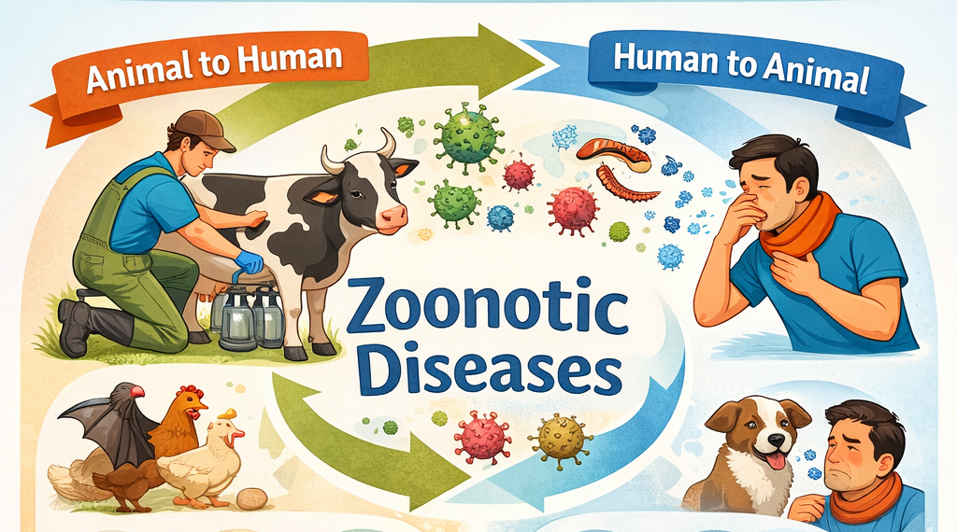
Zoonotic Diseases
There are over 200 zoonotic diseases worldwide.
Zoonotic diseases (zoonoses) are diseases that can be transmitted between animals and people.
60% of known infectious diseases of people are zoonotic.
Zoonotic diseases are an important health risk and concern for people and animals.
Most zoonotic diseases can be avoided with proper prevention measures.
Source: CFSPH – Zoonotic Diseases
Notes:
We are going to talk today about different types of zoonotic diseases – these are diseases that can go back and forth between humans and animals – that can be found on a dairy farm.

Slide 2
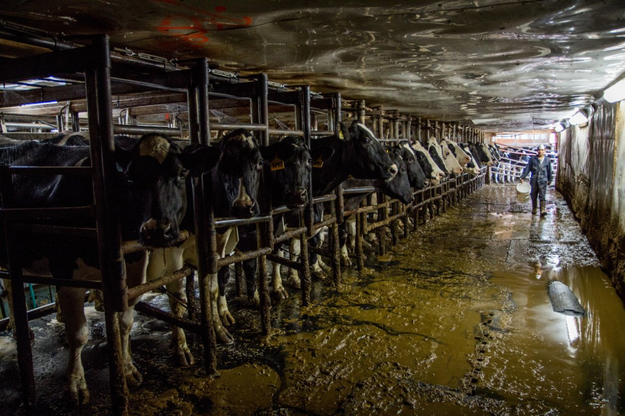
Types, Sources, and Examples of Infections
Diarrhea-causing pathogens
Respiratory infections
Skin/soft tissue infections
Sharps-related infections
Notes:
Examples of the types of infections that are found on dairy farms include diarrhea-causing pathogens, respiratory infections, skin and soft tissue infections and needle stick injuries.

Slide 3
Diarrhea- causing Pathogens
Examples of pathogens
Salmonella​
Cryptosporidium​
Campylobacter​
E coli
Common Sources of Pathogens
​
Manure, especially if cow or calf has diarrhea ​
Surfaces contaminated with manure – (fomites)​
Unpasteurized milk​
How a Worker can be Exposed
Ingestion of contaminated material
Touching contaminated surface then touching eyes, nose, or mouth splashing or splattering of manure
Notes:
This slide discusses diarrhea-causing pathogens, their sources and how workers on the farm can be exposed

Slide 4
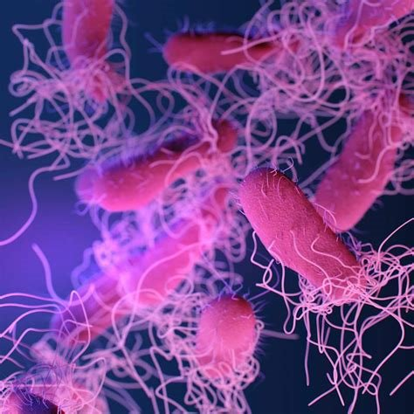
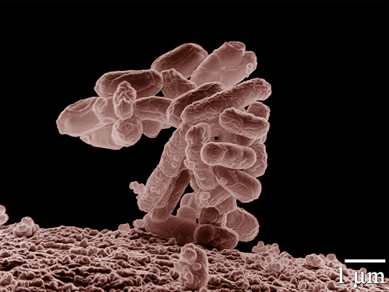
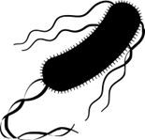
Diarrhea- causing Pathogens
E. coli
Reference: TTT Self-Guide Manual (Page 14)
Salmonella
Notes:
These are the pathogens for Salmonella and E. coli

Slide 5
Respiratory Infections
Infections
Q Fever
Influenzas (such as H5N1)
Other respiratory viruses (such as COVID)
Common Sources of Infectious Pathogens
Birthing materials (Q fever)
Raw milk (avian influenza)
Dust
Spray
Close contact with sick animal or person
How a Worker Can Be Exposed
Inhalation of dust or droplets or other aerosols
Splashing / splattering of body fluids in eyes, nose, and mouth
Reference: TTT Self-Guide Manual (Page 14)
Notes:
This slide discusses the causes of respiratory infections, their sources and how workers on the farm can be exposed

Slide 6
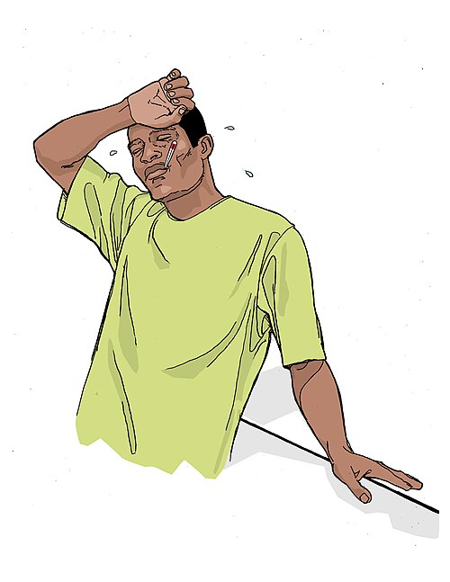
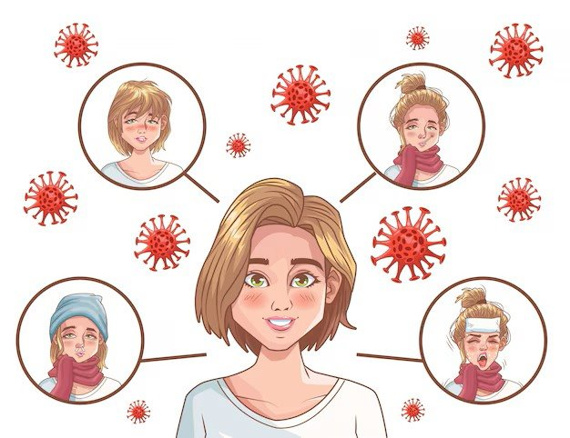
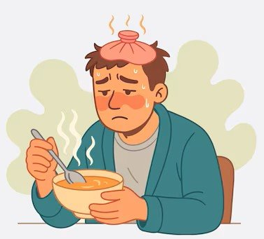
Respiratory Infections
Flu
Fever
Covid-19
Notes:
These are some illnesses and symptoms of respiratory infections

Slide 7
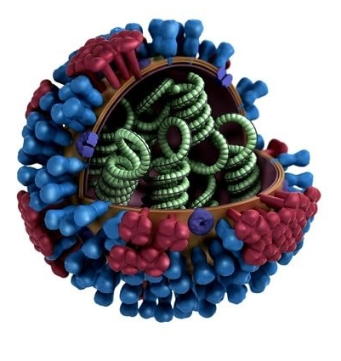
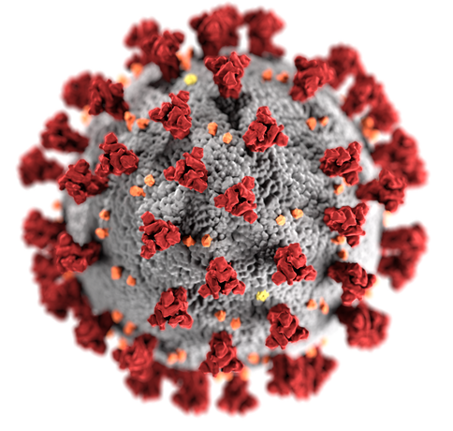
Respiratory Infections
Covid-19 virus
Avian influenza virus
Notes:
Some common respiratory infections that can be found on dairy farms include Covid-19 and Avian influenza

Slide 8
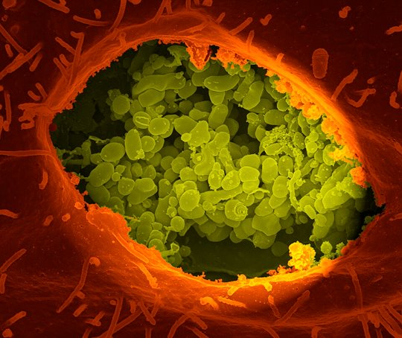
Respiratory Infections
Q fever (Coxiella burnetii)
Source: National Institutes of Health (NIH)
Reference: TTT Self-Guide Manual (Page 14)
Notes:
And Q fever, an pathogen that can cause a lot of acute illness and can lead to miscarriage or fetal death in pregnant women.

Slide 9
Skin/soft Tissue Infections
Infections
Staphylococcus
Streptococcus
Common Sources of Infectious Pathogens
Wound drainage
Nasal secretions
Mastitis fluid from infected cows
How a Worker can be Exposed
Splash or other contact with broken skin, cuts, or wounds
Notes:
This slide discusses the causes of skin and soft tissue infection, their sources and how workers on the farm can be exposed

Slide 10
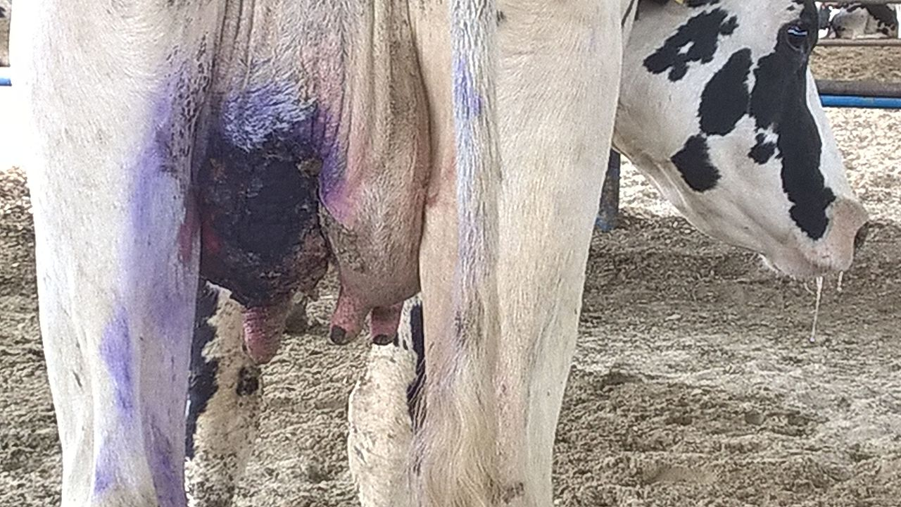
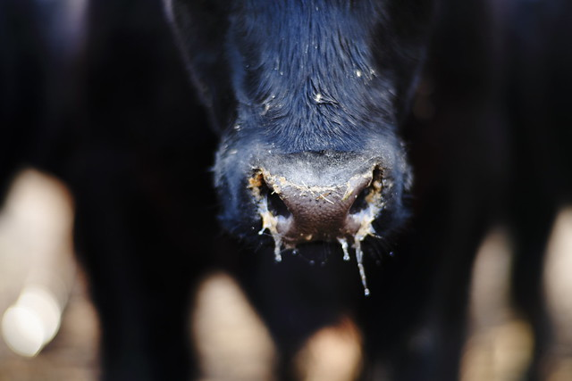

Skin/soft Tissue Infections
Dairy cow with gangrenous mastitis
Photo by Mohammad Golkar
Staphylococcus aureus
Source: U. S. Department of Agriculture
Reference: TTT Self-Guide Manual (Page 14)
Notes:
These include infections like mastitis and Staphylococcus aureus.

Slide 11
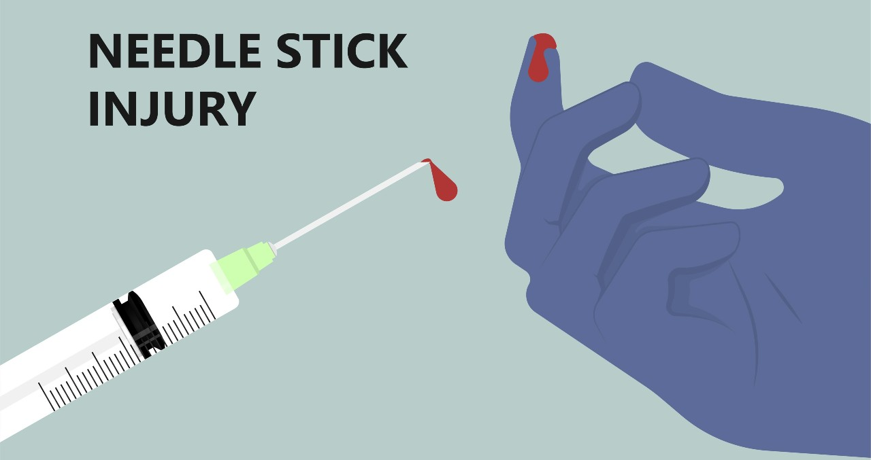

Sharps-related Infections
Scalpel blades​
Notes:
Needle sticks and cuts are a common occurrences in animal agriculture

Slide 12
Sharps-related Infections
Infections
Tetanus
Brucellosis
How a Worker can be Exposed
Needlesticks
Scalpel blades
Other sharp object injury
Common Sources of Infectious Pathogens
Soil (tetanus)
Live brucella vaccine
Injuries from needles and sharp objects
Reference: TTT Self-Guide Manual (Page 14)
Notes:
These injuries can lead to infections such as tetanus and brucellosis

Slide 13
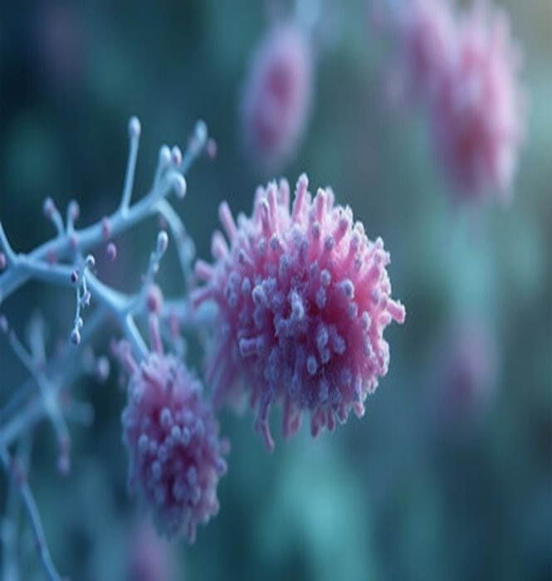
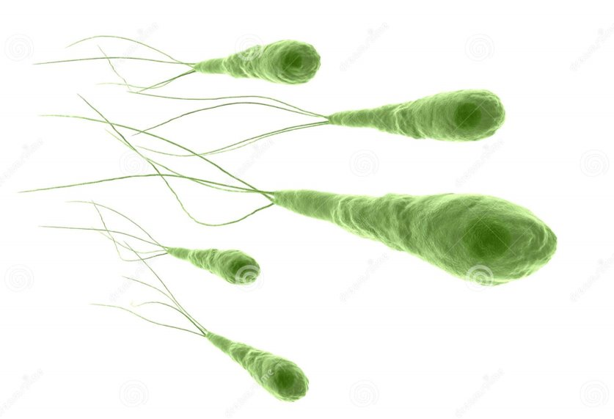
Sharps-related Infections
Tetanus (Clostridium tetani)
Brucella bacteria
Notes:
Symptoms cause by brucellosis in humans are similar to those cause by flu.
Tetanus is a serious disease of the nervous system caused by a toxin-producing bacterium. The disease causes muscle contractions, particularly of your jaw and neck muscles. Tetanus is commonly known as lockjaw. Signs and symptoms of generalized tetanus include:
Painful muscle spasms and stiff, immovable muscles (muscle rigidity) in your jaw
Tension of muscles around your lips, sometimes producing a persistent grin
Painful spasms and rigidity in your neck muscles
Difficulty swallowing
Rigid abdominal muscles

